Slide 1
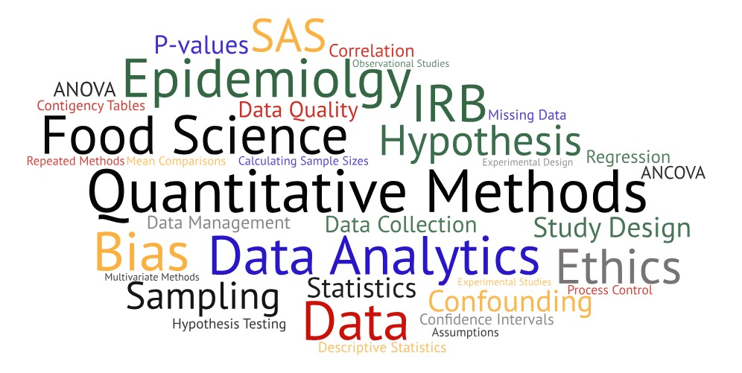
One Health Summer Institute Introduction to Data Analytics, Statistics & Programming in Epidemiologic Research

Slide 2
Advanced Statistical Methods

Slide 3
Statistical Modelling
A model is a description of reality
Models ≠ reality
Usually a simplification
Helps to understand reality
“All models are wrong, but some are useful” (Box)
Complexity of model depends on purpose (e.g. understanding, prediction)
Deterministic models have no randomness and outcome is totally predictable.
Stochastic models include both deterministic and random (stochastic) components
Statistical inference based on data
Based on stochastic models
Trying to quantify the role of chance

Slide 4
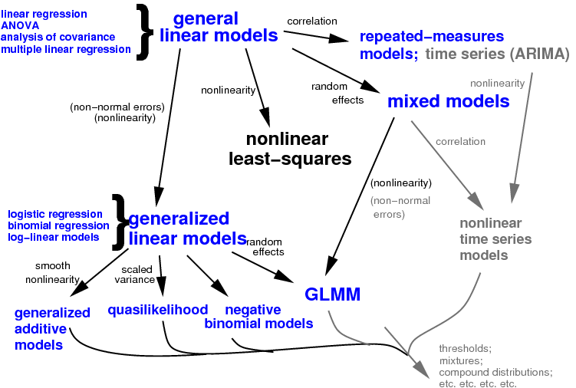
Types of Statistical Models

Slide 5
General Linear Models (GLM)
Basis for most inferential statistics
Broad class of models
(Multiple) linear regression
Analysis of Variance (ANOVA)
Analysis of covariance (ANCOVA)
Examines relationship between variables X and Y
What is association between Y and X?
How can changes in Y be explained by changes in X?
What are functional relationships between Y and X?

Slide 6
It’s About Relationships!
Regression is defined to be functional relationship between two or more variables that is used to predict values of one variable when given values of the others.
e.g. variable Y is regressed on variable X
A function is a mathematical relationship enabling us to predict what values of one variable (Y) correspond to given values of another variable (X).
A functional relationship is written as: $Y=f(X)$
Y is referred to as dependent variable, response variable or predicted variable.
X is referred to as independent variable, explanatory variable or predictor variable.

Slide 7
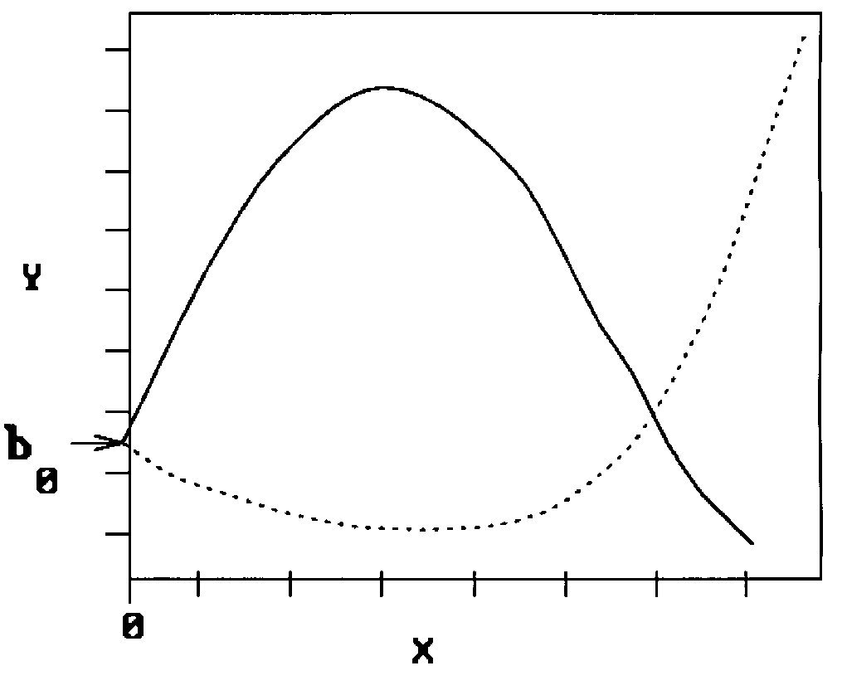
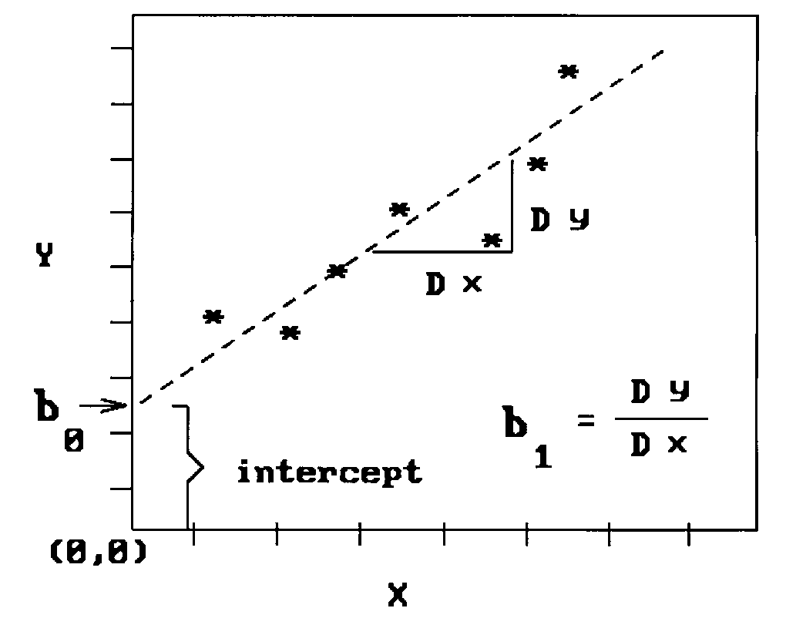
Types of Functional Relationships
Linear relationships
b₀: intercept,
b₁: slope.
Non-linear relationships
b₀: intercept,
b₁: linear coefficient,
b₂: quadratic coefficient.

Slide 8
Model Errors
True relationship between variables is not known.
Proposed functional relationship will not fit exactly.
Errors in measurement (data problems)
Errors in specification (inadequate model)
Error term ($ε$) is included as random variable representing result of both errors in model specification and measurement:
Also called “noise”

Slide 9
General Linear Model
Describes outcome (y) in terms of all its contributing factors (xβ) in a linear combination, while also accounting for contribution of error (e)
$$y=Xβ+e$$
Dependent variable
Describes a response

Slide 10
General Linear Model
Describes outcome (y) in terms of all its contributing factors (xβ) in a linear combination, while also accounting for contribution of error (e)
$$y=Xβ+e$$
Independent Variable
aka. Predictor
e.g. Experimental conditions

Slide 11
General Linear Model
Describes outcome (y) in terms of all its contributing factors (xβ) in a linear combination, while also accounting for contribution of error (e)
$$y=Xβ+e$$
Parameters
Quantifies how much each predictor (X) independently influences dependent variable (Y)
(aka regression coefficient/beta weights)

Slide 12
General Linear Model
Describes outcome (y) in terms of all its contributing factors (xβ) in a linear combination, while also accounting for contribution of error (e)
$$y=Xβ+e$$
Error
Variance in data (y) which is not explained by linear combination of predictors (x)

Slide 13

An Analogy
Start with finished product and try to explain how it is made. . .
You specify which ingredients to add (X).
For each ingredient, GLM finds quantities (β) that produce best reproduction.
Then if you tried to make the cake with what you know about X and β then error would be difference between original cake (data) and yours!
$$y= x_{1}β_{1}+x_{2}β_{2}+x_{3}β_{3}+x_{4}β_{4}+e$$

Slide 14
Determining the Functional Relationship
What if we don’t know the functional form of the relationship?
Look at a scatter plot of the data for suggestions.
Hypothesize about the nature of the underlying process. Often the hypothesized processes will suggest a functional form.
Straight line is conservative starting point. Y=mX+BA slope of 2 means that every 1-unit change in X yields a 2-unit change in Y.

Slide 15
Simple Linear Regression

Slide 16
Regression Analysis
Regression analysis used to:
Predict value of dependent variable based on value of at least one independent variable
Explain impact of changes in independent variable on dependent variable
Interpretation:
When X is fixed at level x, then we assume mean of Y to be linear around level x, where β₀ is intercept and β₁ is slope or incremental change in Y per unit change in X.
β₀ and β₁ are unknown but estimated from sample data (denoted b₀ and b₁).
Simple regression: only one independent variable.
Multiple regression: multiple independent variables.

Slide 17
Simple Linear Regression Model
Population Slope Coefficient
Random Error term
Population Y intercept
Independent Variable
Dependent Variable
Linear component
Random Error
component
Relationship between mean of response variable and level of explanatory variable assumed to be approximately linear
β₀ and β₁ are unknown population parameters
β₁ > 0 ⇒ Positive Association
β₁ < 0 ⇒ Negative Association
β₁ = 0 ⇒ No Association

Slide 18
Simple Linear Regression Model
Y
Observed Value of Y for X_{i}
ε_{i}
Slope = β₁
Predicted Value of Y for X_{i}
Random Error for this X_{i} value
Intercept = β₀
X_{i}
X

Slide 19
Simple Linear Regression Equation
Estimated (or predicted) Y value for observation i
Estimate of the regression intercept
Estimate of the regression slope
Value of X for observation i
Provides estimate of population regression line
Individual random error terms e_{i} have mean of zero
b₀ is estimated average value of Y when X = zero
b₁ is estimated change in average value of Y when there is one-unit change in X

Slide 20
Parameters
y
w
w
w
w
w
w w w w
w
w w
w w
w
x
Quantifies a specific predictor’s (x) contribution to y.
Estimated are determined by:
drawing sample from population of interest,
calculating sample statistics.
producing straight line that cuts into data
But which line?

Slide 21
Finding the Best Line
y_{i}
C
A
B
B
y
A
C
y_{i}
x
Distance between y values and their corresponding estimated values on line are called residuals
Should minimize error (reducing amount of variance in y which is left unexplained – i.e. minimize C²)
Line with best fit is called regression line (or least-squares line)
Line always passes through point defined by mean of Y and mean of X

Slide 22
Method of Least Squares
A good line is one that minimizes sum of squared differences between points and line.
Smaller sum of squared differences → better fit of line to data.
Want line that is best for all points.
Find values b₀ and b₁ that minimize sum of errors.
Method of least squares produces estimates with sampling distributions that are easier to determine.

Slide 23
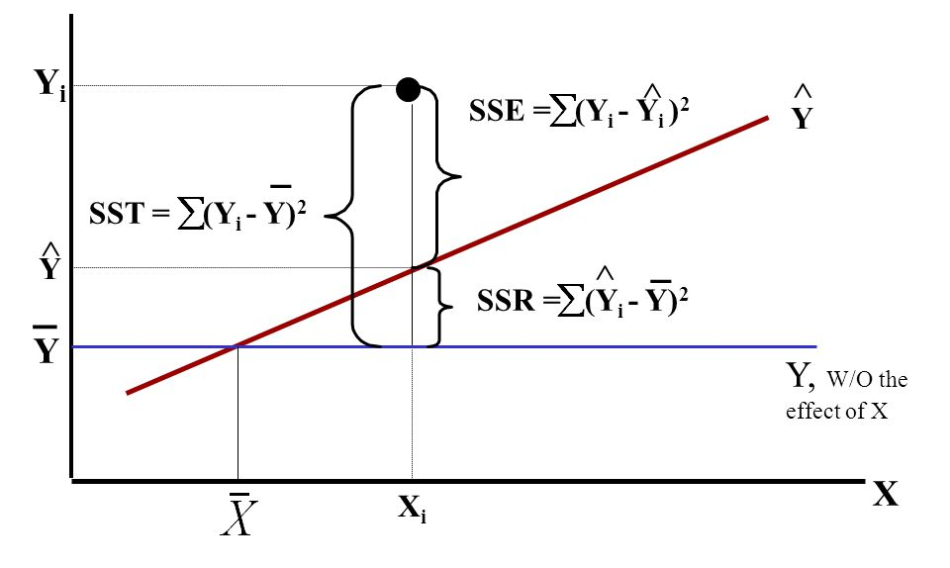
Anatomy of Regression Errors

Slide 24
Measures of Variation
Total variation is made up of two parts:
where $\overline{Y}$ = Average value of the dependent variable
$Y_{i}$ = Observed values of the dependent variable
${\hat{Y}}_{i}$ = Predicted value of Y for the given X_{i} value
Total Sum of Squares
Regression Sum of Squares
Error Sum of Squares
Variation of Y_{i} values around their mean
Variation attributable to relationship between X and Y
Variation attributable to other factors

Slide 25
Sums of Squares About the Mean
Sum of squares about the mean: sum of prediction errors for null (mean model) hypothesis.
Measure of variance of responses.

Slide 26
Regression Sums of Squares
Sum of squares due to the regression: difference between TSS and SSE, i.e. SSR = TSS – SSE.
SSR measures how much variability in the response is explained by the regression.

Slide 27
Residual Sums of Squares
Sum of squares for error: sum of the prediction errors for the alternative (linear regression model) hypothesis.
SSE measures the variance of the residuals, the part of the response variation that is not explained by the model.
Serves as measure of how well the line fits the data.

Slide 28
Sums of Squares
Sums of squares of x.
Sums of squares of y.
Sums of cross products of x and y.

Slide 29
Mean Square Error (MSE)
Mean square error (MSE) provides estimate of σ ², and the notation s² is also used.
Root mean square error (RMSE) provides estimate σ .
s² = MSE = SSE/(n-2)

Slide 30
Mean Square Terms
Mean square total (Sample variance of y)
Regression Mean Square
Residual Mean Square

Slide 31
Assumptions

Slide 32
Assumptions
Linear relationship – relationship between X and Y is linear
Normality – Y is distributed normally at each value of X
Probability distribution of error term is normal.
Mean of error term is zero: E(e) = 0.
Standard deviation of error term is s_{e} for all values.
Homogeneity of variances – variance of Y is same at each value of X
Independent observations

Slide 33
Normality
Assumes normality of sampling distribution of means.
Sampling distribution of each level of independent variable is relatively normal.
Assumes y is normally distributed with mean E(y) = β₀ + β₁x, and constant standard deviation σ_{ε}
Individual distributions should be checked for skewness and kurtosis and presence of outliers.
If assumption not met, consider using transformations.

Slide 34
Homogeneity of Variances
Group variances are equal and reflect population variance.
Homoscedasticity = assumption met
Heteroscedasticity = assumption not met
Diagnose heteroscedasticity by plotting residuals against predicted y.
Can test with:

Slide 35
Independence
Independent observations
No correlation between error terms
No correlation between independent variables and error
Assume size of error for one observation is not related to size of error in another observation
Violation (autocorrelation)
Subject used more than once (repeated measures)
Subjects are ran in groups
Graph residuals against time.
No pattern observed if errors are independent.
Positively correlated data inflates standard error

Slide 36
Outliers
An outlier is unusually small or large observation.
Several possibilities need to be investigated when an outlier is observed:
Error in recording the value.
Does not belong in the sample.
Observation is valid.
Identify outliers from scatter diagram.
It is customary to suspect observation is outlier if its |standard residual| > 2

Slide 37
Checking Assumptions – Diagnostics
Develop model with theoretical basis.
Gather data for variables in the model.
Use scatter diagram to determine if linear model appears to be appropriate.
Determine regression equation.
Check required conditions for errors.
Check for outliers and influential observations.
Assess model fit.
If model fits data, use regression equation.

Slide 38
Residual Analysis
Violations of assumptions and model adequacy can be easily investigated by examining residuals.
Examine for linearity assumption
Examine for constant variance for all levels of X
Evaluate normal distribution assumption
Evaluate independence assumption
Residual for an observation is difference between observed and predicted values:
If model is adequate, residuals should contain no obvious patterns.

Slide 39
Residual Analysis for Linearity
Y
Y
x
x
residuals
x
x
residuals
Not Linear
✓
Linear

Slide 40
Residual Analysis for Homoscedasticity
Y
Y
x
x
residuals
x
x
residuals
✓
Non-constant variance
Constant variance

Slide 41
Residual Analysis for Independence
residuals
X
residuals
X
residuals
X
✓
Not Independent
Independent

Slide 42
Autocorrelation
Autocorrelation is correlation of errors (residuals) over time
Residuals show cyclic pattern, not random
Violates assumption that residuals are random and independent

Slide 43
Robustness
A robust test is one that is said to be fairly accurate even if assumptions are not met.
Often used to refer to methods designed to be insensitive to distributional assumptions (such as normality) in general, and unusual observations (“outliers”) in particular.

Slide 44
Estimating the Model

Slide 45
Estimating the Model
Estimated (or predicted) Y value for observation i
Estimate of the regression intercept
Estimate of the regression slope
Value of X for observation i

Slide 46
Inferences about Slope
Parameter: Slope in population model ($β$₁)
Estimator: Least squares estimate
Estimated standard error:
where = Standard error of the estimate

Slide 47
Comparing Standard Errors of Slope
$S_{b_{1}}$ is measure of variation in slope of regression lines from different possible samples
Y
Y
X
X

Slide 48
Hypothesis Test for Slope
2-Sided Test 1-sided Test
H₀: β₁ = 0 H₀: β₁ = 0
H_{A}: β₁ ≠ 0 H_{A}⁺: β₁ > 0 or H_{A}⁻: β₁ < 0
Test Statistic: $t_{obs}= \frac{{\hat{β}}_{1}}{{\hat{σ}}_{{\hat{β}}_{1}}}= \frac{{\hat{β}}_{1} − 0}{\sqrt{{MSE}/{S_{XX}}}}$ $= \frac{{\hat{β}}_{1} − 0}{s/{\sqrt{S_{XX}}}}$
Rejection Region: $\left|t_{obs}\right|≥t_{\frac{α}{2},n−2}$
$$t_{obs}≥t_{α,n−2} or { t}_{obs}≤{−t}_{α,n−2}$$
P-value: $P(t≥\left|t_{obs}\right|)$
$P(t≥t_{obs})$ or $P(t≤t_{obs})$

Slide 49
Confidence Interval for Slope
Conclude positive association if entire interval above 0
Conclude negative association if entire interval below 0
Cannot conclude an association if interval contains 0
Conclusion based on interval is same as 2-sided hypothesis test

Slide 50
Assessing the Model
Least squares method will produces regression line whether or not there is a linear relationship between x and y.
Consequently, it is important to assess how well the linear model fits the data.
Several methods are used to assess the model. All are based on the sum of squares for errors, SSE.

Slide 51
F-test for Significance
Compares the fits of different linear models – tells you if a group of variables are jointly significant
Tests if Both MSE and MSR measure same underlying variance quantity under the assumption that null (mean) model holds.
Under alternative hypothesis, MSR should be much greater than the MSE.
Ratio should be near 1 if all regression coefficients are equal to zero
F distribution is determined by degrees of freedom due to effect and degrees of freedom due to error.

Slide 52
F-test
H₀: No significant regression fit.
H_{A}: Regression explains significant amount of variability in response.
or
Slope of regression line is significant.
or
X is significant predictor of Y.
Test Statistic: $F= \frac{MSR}{MSE}= \frac{{SSR}/k}{{SSE}/{n−k−1}}$
where F follows an F distribution with k numerator and (n – k - 1) denominator degrees of freedom (k = number of independent variables in the regression model)
Reject H₀ if:

Slide 53
Coefficient of Determination, r²
The coefficient of determination is the portion of the total variation in the dependent variable that is explained by variation in the independent variable
The coefficient of determination is also called r-squared and is denoted as r²
Note: $0 ≤ r^{2}≤1$

Slide 54
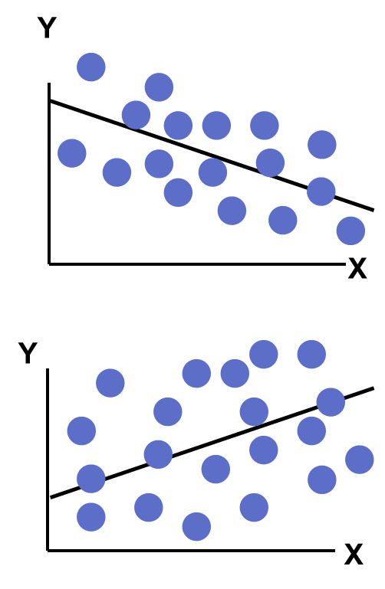
Examples of Approximate r² Values
Y
X
Y
Y
X
X
r² = 1
0 < r² < 1
r² = 0
Perfect linear relationship: 100% of variation in Y is explained by variation in X
Weaker linear relationship:
Some but not all of variation in Y is explained by variation in X
No linear relationship:
None of variation in Y is explained by variation in X

Slide 55
Standard Error of Estimate (σ_{ε} )
Y
Y
X
X
Measure of variation of observed Y values from regression line
If σ_{ε} small, errors tend to be close to zero (mean error) → model fits data well.
Can use σ_{ε} as measure of suitability of using linear model.
Estimator of σ_{ε} is given by S_{ε} or S_{YX}: $S_{YX}=\sqrt{{SSE}/{(n−2)}}$
Magnitude of S_{YX} should always be judged relative to size of Y values in sample data

Slide 56
Estimating Means and Predicting Values
Goal: Form intervals around Y to express uncertainty about the value of Y for a given X_{i}
Confidence Interval for the mean of Y, given X_{i}
Y

Y

Y = b₀+b₁X_{i}
Prediction Interval for an individual Y, given X_{i}
X_{i}
X

Slide 57
Confidence Interval
Confidence interval estimate for mean value of Y given a particular X_{i}
Size of interval varies according to distance away from mean, X

Slide 58
Prediction Interval
Confidence interval estimate for individual value of Y given particular X_{i}
This extra term adds to the interval width to reflect the added uncertainty for an individual case

Slide 59
Steps in Regression Analysis
Examine scatterplot of data.
Does the relationship look linear?
Are there points in locations they shouldn’t be?
Do we need a transformation?
If linear function looks appropriate, estimate regression parameters.
How do we do this? (Method of Least Squares)
Test if there is statistically significant linear relationship.
How do we test this? (F-test for Variances)
If there is a significant linear relationship, estimate response (Y) for given values of X and compute residuals.
Examine residuals for systematic inadequacies in model fit.
Is there evidence that a more complicated relationship should be considered; are there problems with the regression assumptions?
Are there specific data points which do not seem to follow proposed relationship?

Slide 60
Regression Pitfalls
Lacking an awareness of the assumptions underlying least-squares regression
Not knowing how to evaluate the assumptions
Not knowing the alternatives to least-squares regression if a particular assumption is violated
Using a regression model without knowledge of the subject matter
Extrapolating outside the relevant range

Slide 61
Interpolation vs. Extrapolation
When using regression model for prediction, only predict within relevant range of data
Relevant range for interpolation
Do not try to extrapolate beyond the range of observed X’s

Slide 62
Strategies for Avoiding Pitfalls
Start with scatter plot of X on Y to observe possible relationship
Perform residual analysis to check assumptions
Plot residuals vs. X to check for violations of assumptions such as homoscedasticity
Use histogram, stem-and-leaf display, box-and-whisker plot, normal probability plot of residuals to assess non-normality
If assumptions violated, use alternative methods or models
If no evidence of assumption violation, test for significance of regression coefficients, construct confidence intervals and prediction intervals
Avoid making predictions or forecasts outside relevant range

Slide 63
ANOVA

Slide 64
Analysis of Variance (ANOVA)
Goal is to identify important independent variables and determine how they affect dependent variables.
Significant relationship between independent and dependent variables
Measurable difference exists between sample means
Null hypothesis is no relationship or all means are equal
Investigator controls one or more independent variables
Dependent variable is continuous
Independent variables are categorical and called factors
Combination of factor levels are called treatments
Each factor contains two or more levels (or groups or categories)
Observe effects of independent variables on dependent variable
Response to levels of independent variable

Slide 65
Why is it called Analysis of Variance?
If we are interested in means, why look at variance?
Variance of group means around central tendency tells us, on average, how much each group is different from central tendency and each other
Measure of central tendency is called grand mean
Separates total variability into two groups:
Variability of each group mean around grand mean
Variability of individual observations around group mean
Compare average variability around grand mean to average variability around each group mean
If null hypothesis, ratio should be about 1

Slide 66
Classes of ANOVA
Depends on number and type of independent variables
One-way ANOVA involves single factor.
Treatment is same as a factor level.
N-way ANOVA involves two or more factors.
Analysis of Covariance (ANCOVA) involves categorical and continuous independent variables
Continuous independent variables are covariates.
Multivariate ANOVA (MANOVA) involves multiple dependent variables
ANOVA and T-test are similar
Both work for 2 populations (groups)
ANOVA better for 2 or more populations (groups)

Slide 67
ANOVA Assumptions
Normal populations
E(ε_{i}) = 0
ε_{i} ~ N(0,σ²)
Equal (unknown) population variances
Homoscedasticity: Var(ε₁) = Var(ε₂) = … = Var(ε_{k})
Independent samples
All ε_{i}’s are independent.
Uncorrelated

Slide 68
Conducting One-Way ANOVA
Identify the Dependent and Independent Variables
Decompose the Total Variation
Measure the Effects
Test the Significance
Interpret the Results

Slide 69
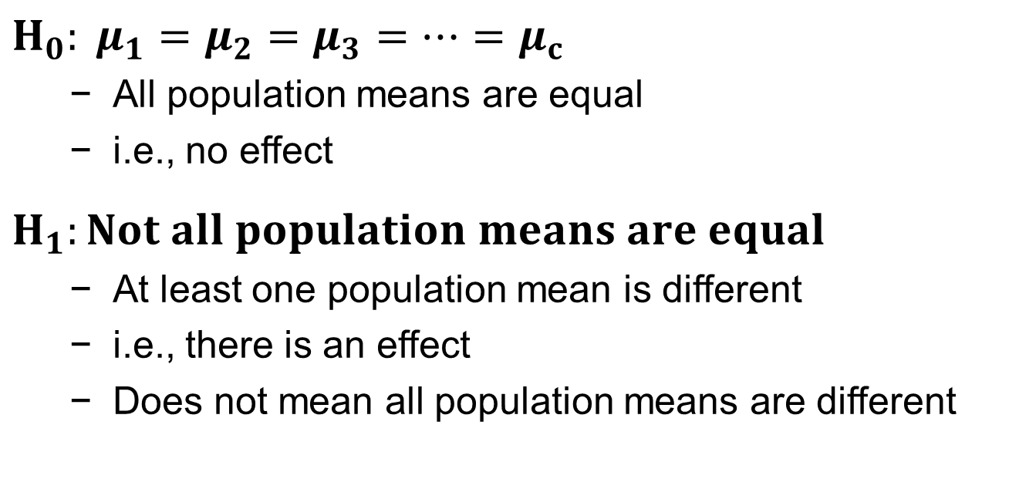
Hypotheses for One-Way ANOVA
$$H_{0}: μ_{1}=μ_{2}=μ_{3}=⋯=μ_{c}$$
All population means are equal
i.e., no effect
$$H_{1}:Not all population means are equal$$
At least one population mean is different
i.e., there is an effect
Does not mean all population means are different

Slide 70
Partitioning Variation
Total variation
Aggregate dispersion of individual data across factor levels
SST = SS_{y} = Total Sum of Squares
Among-group variation
Variation due to factor
Dispersion between factor sample means
SSA = SS_{x} = Sum of Squares Among Groups
Within-group variation
Variation due to random sampling
Dispersion among data values within a factor level
SSW = SS_{error} = Sum of Squares Within Groups

Slide 71
Partitioning Variation
SST = SSA + SSW
Total Variation (SST)
Variation Due to Factor (SSA)
+
Variation Due to Random Sampling (SSW)
=
Commonly referred to as:
Sum of Squares Between
Sum of Squares Among
Sum of Squares Explained
Among Groups Variation
Commonly referred to as:
Sum of Squares Within
Sum of Squares Error
Sum of Squares Unexplained
Within Groups Variation

Slide 72
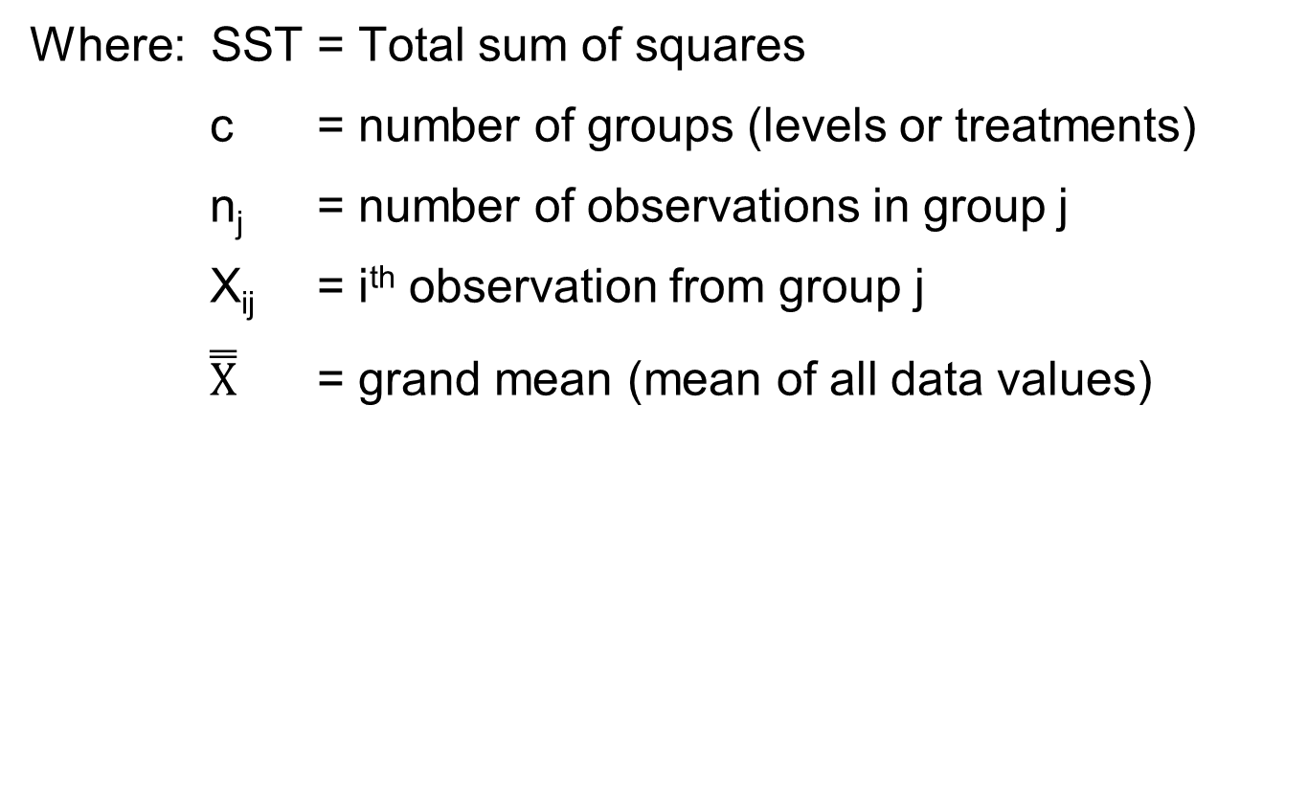
Total Variation (SST)
Where: SST = Total sum of squares
c = number of groups (levels or treatments)
n_{j} = number of observations in group j
X_{ij} = i^{th} observation from group j
$\overset{̿}{X}$ = grand mean (mean of all data values)

Slide 73
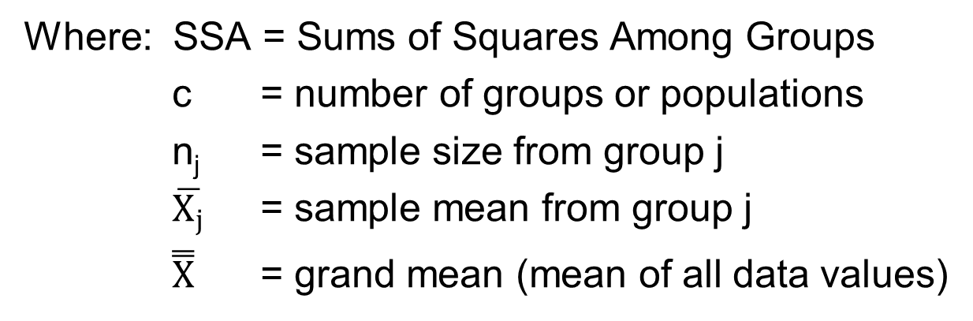
Variation Due to Differences Among Groups
Where: SSA = Sums of Squares Among Groups
c = number of groups or populations
n_{j} = sample size from group j
$\overline{X_{j}}$ = sample mean from group j
$\overset{̿}{X}$ = grand mean (mean of all data values)

Slide 74
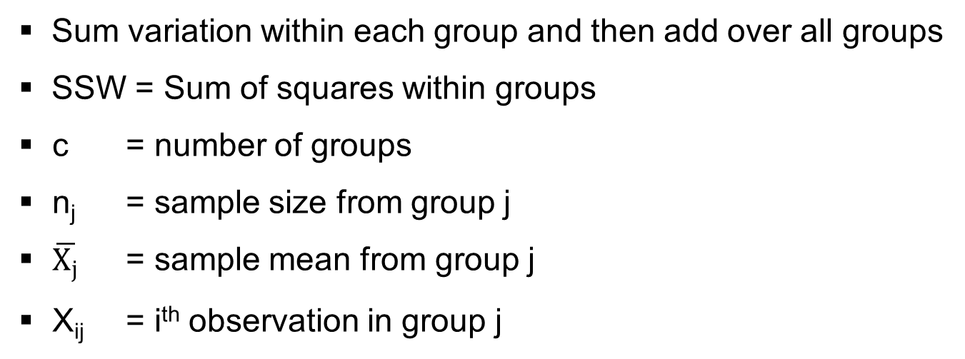
Variation Due to Differences Within Groups
Sum variation within each group and then add over all groups
SSW = Sum of squares within groups
c = number of groups
n_{j} = sample size from group j
$\overline{X_{j}}$ = sample mean from group j
X_{ij} = i^{th} observation in group j

Slide 75
One-way ANOVA F-Statistic
F statistic. Null hypothesis that category means are equal is tested by F statistic.
F statistic is based on ratio of variance between groups and variance within groups.
Variances are related to sum of squares.
The F statistic is the ratio of the among estimate of variance and the within estimate of variance
The ratio must always be positive
df₁ = c -1 will typically be small
df₂ = n - c will typically be large

Slide 76
One-way ANOVA F-Statistic
H₀: μ₁= μ₂ = … = μ_{c}
H₁: At least two population means are different
Test statistic:
Degrees of freedom
df₁ = c – 1 (c = number of groups)
df₂ = n – c (n = sum of sample sizes from all populations)
Decision Rule:
Reject H₀ if F > F_{U}, otherwise do not reject H₀
α = .05
0
Do not
reject H₀
Reject H₀
F_{U}

Slide 77
Tukey-Kramer Procedure
μ
μ
μ
=
Tells which population means are significantly different
Done after rejection of equal means in ANOVA
Allows pair-wise comparisons
Compare absolute mean differences with critical range
where: Q_{U} = Value from Studentized Range Distribution with c and n - c degrees of freedom for desired level of α
MSW = Mean Square Within
n_{i}, n_{j} = Sample sizes from groups j and j’
1
2
3
x

Slide 78
One-Way ANOVA Table
Source of Variation
SS
df
MS
(Variance)
F ratio
SSA
MSA
Among Groups
SSA
c - 1
MSA =
F =
c - 1
MSW
SSW
Within Groups
SSW
n - c
MSW =
n - c
Total
SST =
SSA+SSW
n - 1

Slide 79
Two-way ANOVA
Examines effect of two factors of interest on dependent variable
e.g., Percent carbonation and line speed on soft drink bottling process
Interaction between different levels of two factors
e.g., Does the effect of one particular carbonation level depend on which level the line speed is set?
Assumptions
Populations are normally distributed
Populations have equal variances
Independent random samples are drawn

Slide 80
Two-way ANOVA Sources of Variation
SST = SSA + SSB + SSAB + SSE
Degrees of Freedom:
SSA
Factor A Variation
r – 1
SST
Total Variation
SSB
Factor B Variation
c – 1
SSAB
Variation due to interaction
between A and B
(r – 1)(c – 1)
n - 1
SSE
Random variation (Error)
rc(n’ – 1)
r = number of levels of factor A
c = number of levels of factor B
n’ = number of replications for each cell
n = total number of observations in all cells (n = rcn’)
X_{ijk} = value of k^{th} observation of level i of factor A and level j of factor B

Slide 81
Two-way ANOVA Equations
Total Variation:
Factor A Variation:
Factor B Variation:
Interaction Variation:
Sum of Squares Error:

Slide 82
Two-way ANOVA Equations

Slide 83
Mean Square Calculations

Slide 84
Two-way ANOVA F-test
F Test for Factor A Effect
H₀: μ_{1..} = μ_{2..} = μ_{3..} = • • •
H₁: Not all μ_{i..} are equal
Reject H₀ if F > F_{U}
F Test for Factor B Effect
H₀: μ_{.1.} = μ_{.2.} = μ_{.3.} = • • •
H₁: Not all μ_{.j.} are equal
Reject H₀ if F > F_{U}
H₀: Interaction of A and B is equal to zero
H₁: Interaction of A and B is not zero
F Test for Interaction Effect
Reject H₀ if F > F_{U}
Degrees of freedom always add up: n-1 = rc(n’-1) + (r-1) + (c-1) + (r-1)(c-1)
Denominator of F Test is always same but numerator is different

Slide 85
Two-way ANOVA Table
Source of Variation | Sum of Squares | Degrees of Freedom | Mean Squares | F Statistic
Factor A | SSA | r – 1 | MSA = SSA /(r – 1) | MSA MSE
Factor B | SSB | c – 1 | MSB = SSB /(c – 1) | MSB MSE
AB (Interaction) | SSAB | (r – 1)(c – 1) | MSAB = SSAB / (r – 1)(c – 1) | MSAB MSE
Error | SSE | rc(n’ – 1) | MSE = SSE/rc(n’ – 1)
Total | SST | n – 1

Slide 86
Interpreting Results
If null hypothesis of equal category means is not rejected, then independent variable does not have significant effect on dependent variable.
If null hypothesis is rejected, then effect of independent variable is significant.
Comparison of category mean values will indicate nature of effect of independent variable.

Slide 87
N-Way Analysis of Variance
Consider two factors X₁ and X₂ having categories c₁ and c₂.
Significance of overall effect is tested by an F test
If overall effect is significant, examine significance of interaction effect. This is also tested using F test.
Significance of main effect of each factor may be tested using F test as well.

Slide 88
ANCOVA

Slide 89
Analysis of Covariance
Combines linear regression and ANOVA
Often have uncontrolled independent variables that could influence dependent variable (covariates)
Covariates (or concomitant variables) are continuous variables
Including covariates in model will help explain response and reduce error variance
Similar to blocking
Failure to include covariates can lead to misleading results
Goal is to compare k treatments, after controlling for quantitative factor believed to be related to response
Basically adjust value of dependent variable so covariate takes on average value for each case

Slide 90
Why ANCOVA?
Allows you to compare mean differences while removing variance from 3rd variable
Removing variance that is unrelated to independent variable = removing error variance
Makes ANCOVA potentially a very powerful test (i.e. easier to find significant results than with ANOVA alone) by potentially reducing Ms_{error}
Generally, more strongly related covariate and dependent variable are, and unrelated covariate and independent variable are, more useful (statistically) covariate will be in reducing Ms_{error}
ANCOVA should not be used as a substitute for good research design
covariates change the meaning of your DV
DO NOT just add covariates thinking it will help you find significant results
Adding covariate highly correlated with pre-existing covariate actually makes ANCOVA less powerful
df decreases slightly with each covariate
No increase in power since correlated covariates remove same variance

Slide 91
ANOVA vs ANCOVA
ANOVA
Ignores covariate
Attributes between-group variation exclusively to treatment
Attributes within-group variation exclusively to individual differences
ANCOVA
Considers covariate (multivariate analysis)
Separates between-group variation into treatment and covariate
Separates within-group variation into individual differences and covariate
F-test of treatment effect controls for covariate using individual differences as error term
F-test of covariate effect controls for treatment using individual differences as error term

Slide 92
ANOVA vs ANCOVA
Hypotheses are slightly different than for ANOVA
H₀: Group means are equal after controlling for covariate
H₁: Group means are not equal after controlling for covariate
Adjust Sum of Squares of independent variable to remove influence of covariate
SS_{error} for ANCOVA will always be smaller than SS_{error} for ANOVA
part of ANOVA error partitioned into covariate of ANCOVA
SS_{IV} for ANCOVA may be =, < or > than SS_{IV} for ANOVA
depends on the “direction of effect” of IV & Covariate
Sums of squares must now also be calculated for covariate!
Using adjusted Sum of Squares, run ANOVA to see if there is a difference

Slide 93
Applications of ANCOVA
“correcting” assessment of relationship for within group variability attributable to covariate
Usually increases F
“correcting” assessment of relationship for between group variability attributable to covariate
Increases or decreases F by increasing or decreasing treatment effect
Depends on whether covariate and treatment effects are in “same” or “opposite” directions
“correcting” for both influences of covariate upon F
F will change as a joint influence of decreasing “error variation” and increasing/decreasing “systematic variation”

Slide 94
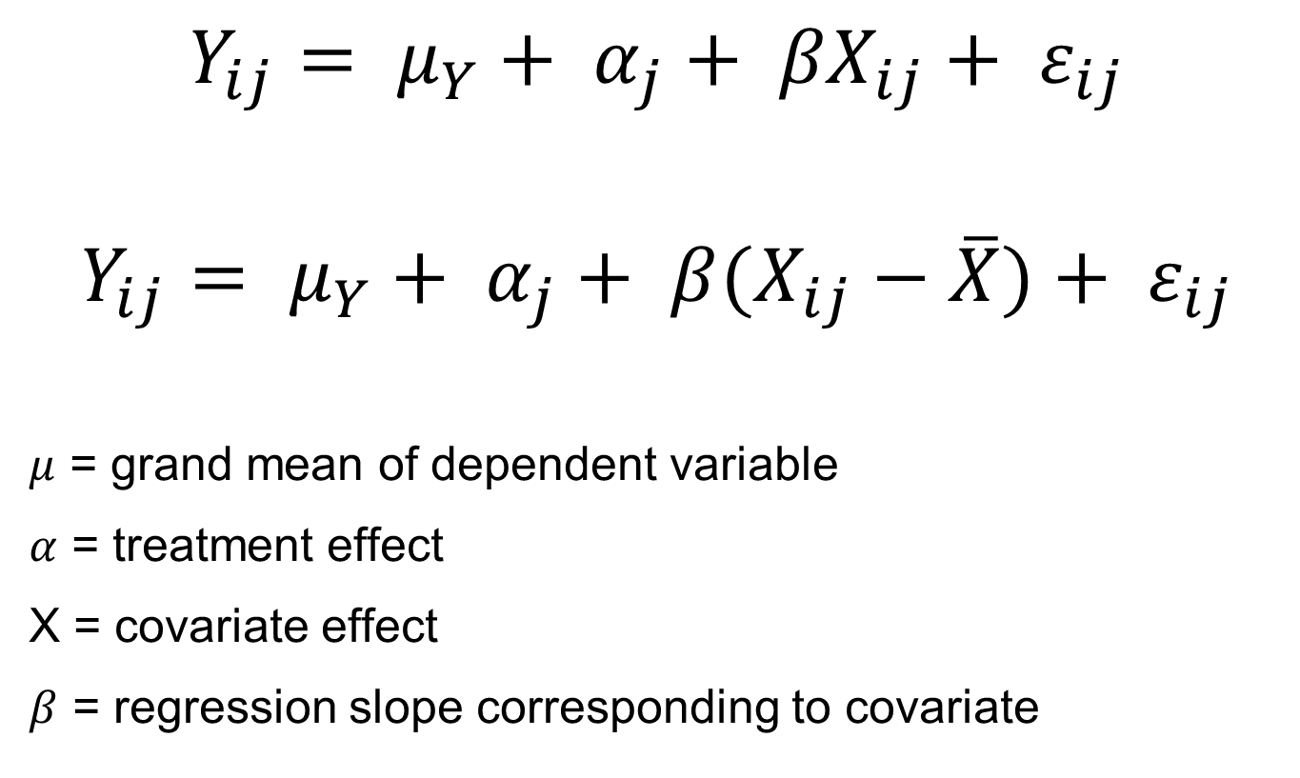
ANCOVA Model
$$Y_{ij}= μ_{Y}+ α_{j}+ {βX}_{ij}+ ε_{ij}$$
$$Y_{ij}= μ_{Y}+ α_{j}+ {β(X}_{ij}−\overline{X})+ ε_{ij}$$
$μ$ = grand mean of dependent variable
$α$ = treatment effect
X = covariate effect
$β$ = regression slope corresponding to covariate

Slide 95
ANCOVA Assumptions
Variance is normally distributed (normality)
Variance is equal between groups (homoscedasticity)
Observations are independent
Relationship between covariate and dependent variable is linear
Relationship will be same for all levels of factor
AKA Homogeniety of Regression Slopes
i.e. Interaction between IV and CV

Slide 96
More on Assumptions
Covariate is related to response, and can account for variation in response.
Check with scatterplot of Y vs. X.
Covariate is NOT related to treatments.
If Y is related to X, then variance of treatment differences is increased relative to that obtained from ANOVA model without X, which results in a loss of precision.
Treatment’s regression equations are linear in covariate.
Check with scatterplot of Y vs. X, for each treatment.
Non-linearity can be accommodated but analysis may be more complex.
Regression lines for different treatments are parallel.
This means there is only one slope in Y vs. X plots.
Non-parallel lines can be accommodated, but complicates analysis since treatment differences depend on value of X.

Slide 97
Absence of Multicollinearity
Multicollinearity is the presence of high correlations between covariates.
If there are more than one covariate and they are highly correlated they will cancel each other out of the equations.
If the correlations nears 1, this is known as singularity.
One of covariates should be removed

Slide 98
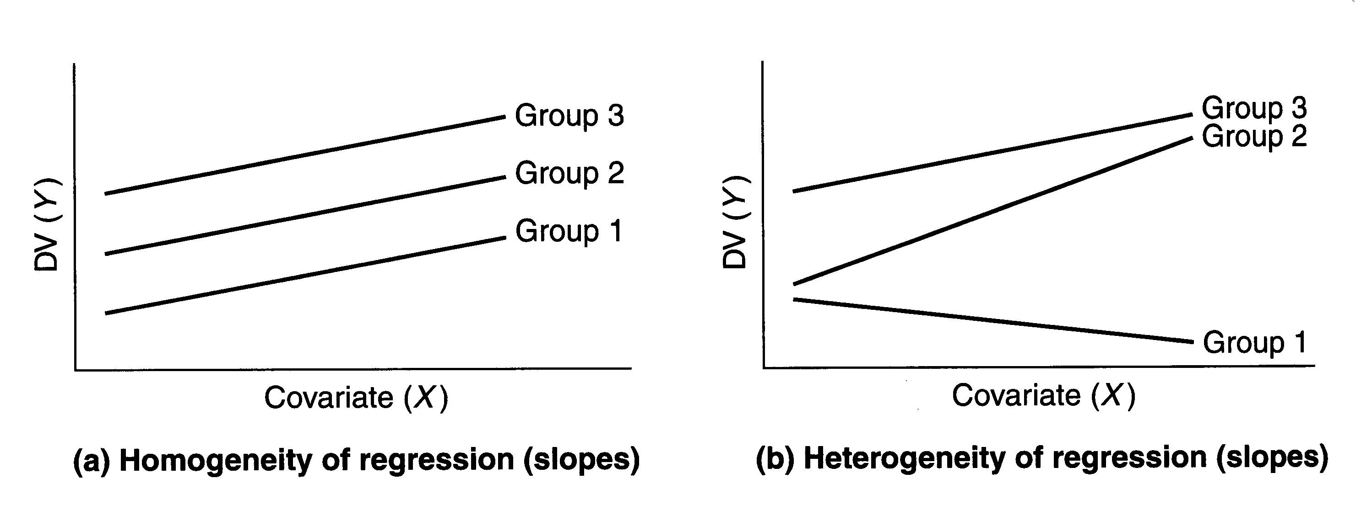
Homogeneity of Regression
Test by running ANCOVA including independent variables and interaction term
If interaction term is significant, assumption is invalid.
If interaction term is insignificant, remove interaction term from model.

Slide 99
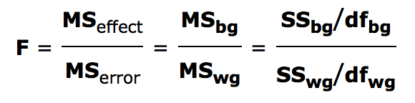
F-test in ANCOVA
F test in ANCOVA is same as ANOVA except:
Using adjusted values of SS_{bg(Y)} and SS_{wg(Y)}, along with adjusted value of df.
df_{bg(Y)} = k – 1 where k = number of groups
adj df_{wg(Y)} = N – k – 1 where N = total number of observations
If it is significant, group means statistically differ after controlling for effect of covariates

Slide 100
Issues in Interpretation
Interactions
The different interactions that can arise when conducting ANOVA on two or more factors.
Relative Importance of Factors
It is important to determine the relative importance of each factor in explaining the variation in the dependent variable.
Multiple Comparisons

Slide 101
Interaction Effects
No interaction:
Interaction is present:
Factor B Level 1
Factor B Level 1
Factor B Level 3
Mean Response
Mean Response
Factor B Level 2
Factor B Level 2
Factor B Level 3
Factor A Levels
Factor A Levels

Slide 102
Plotting ANCOVAs
ANCOVA plot should use continuous covariate variable plotted on x-axis, and continuous response variable plotted on y-axis.
Each point represents independent replicate, and different symbols or colors should be used for each treatment group.
A
B
C
D
E
F

Slide 103
An Example…
An animal scientist wishes to examine impact of new dietary supplements on calf weight gain (response).
Three treatments are defined:
standard diet
standard diet + supplement Q
standard diet + supplement R.
All new calves from large herd are study units. She selects 30 calves and randomly assigns each to three diets (completely randomized design).
Initial weights are recorded, then calves are placed on diets. At end of four weeks, final weight is taken and weight gain is computed.
Simple analysis of variance and associated multiple comparisons procedures indicate no significant differences in weight gain between two supplementary diets, but big differences between the supplemental diets and standard diet.

Slide 104
ANOVA Results
Average Weight Gain
(Response g/day)
xx
x xx x x xx
Standard
Diet
xxx
xxx x xx
+ Supplement Q
xx x
x x xx x x x
+ Supplement R
Simple ANOVA of a one-way classification suggests no difference between Supplements Q and R but both different from Standard diet.

Slide 105
Initial Weights
Initial Weight
xx x
x xx x x xx
Standard
Diet
xx
x xxxx x xx
+ Supplement Q
x x x
xx xx x x x
+ Supplement R
Plotting of initial weights by group shows that groups were not equal when it came to initial weights.

Slide 106
Relationship between Weight Gain and Age
Weight (kg)
age
If animals come into study at different ages, they have different initial weights and are at different points on growth curve.
Expected weight gains will be different depending on age at entry into study.

Slide 107
Regression of Initial Weight to Weight Gain
Weight
Gain
(g/day)
(Y)
Initial
Weight
(x)
If we disregard age of animal and focus on initial weight, we see linear relationship between initial weight and weight gain expected.

Slide 108
Covariates
Initial weight in the previous example is covariate.
If animal scientist knew calves were very variable in initial weight (or age), she could have:
Created blocks of 3 or 6 equal weight animals, and randomized treatments to calves within these blocks.
This would have entailed some cost in terms of time spent sorting the calves and then keeping track of block membership over the life of the study.
It was much easier to simply record the calf initial weight and then use analysis of covariance for the final analysis.
In many cases, due to the continuous nature of the covariate, blocking is just not feasible.

Slide 109
Expectations under H_{o}
H_{o}: No treatment effects.
Expected
Weight
Gain
(g/day)
(Y)
Initial
Weight
(x)
Average Weight Animal
Under null hypothesis, if all animals had come in with same initial weight, all three treatments would produce same weight gain.

Slide 110
Expectations under H_{A}
H_{a}: Significant Treatment effects
+ Supplement Q (q)
+ Supplement R (r)
WG_{Q}
Standard Diet (c)
WG_{R}
WG_{s}
Expected
Weight
Gain
(g/day)
(Y)
Initial
Weight
(x)
Average Weight Animal
Different treatments produce different weight gains for animals of same initial weight.

Slide 111
Different Initial Weight
H_{o}: No treatment effects.
WG_{R}
WG_{s}
WG_{Q}
Expected
Weight
Gain
(g/day)
(Y)
cc c
c cc c c cc
qq
q qqqq q qq
r r r
rr rr r r r
Initial
Weight
(x)
If the average initial weights in the treatment groups differ, the observed weight gains will be different, even if treatments have no effect.

Slide 112
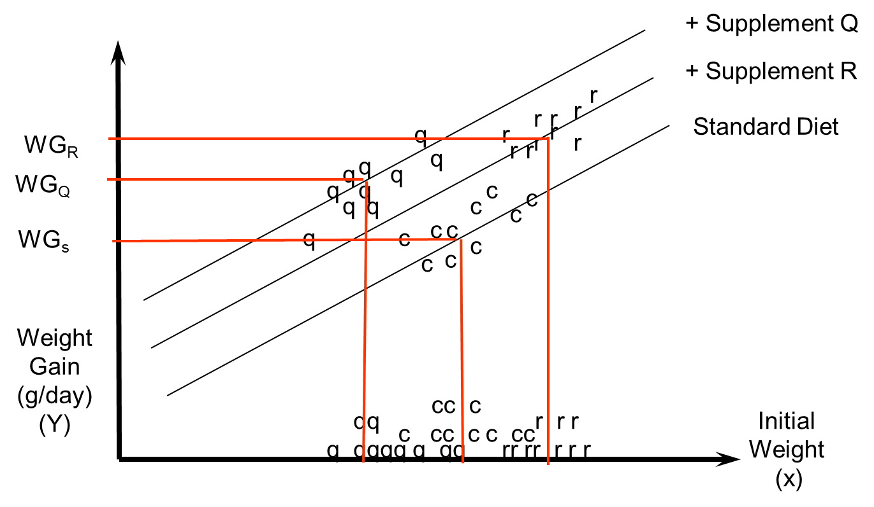
Observed Responses under H_{A}
H_{A}: Significant Treatment effects
Suppose now that different supplements actually do increase weight gain.
This translates to animals in different treatment groups following different, but parallel regression lines with initial weight.
What difference in weight gain is due to Initial weight and what is due to Treatment?

Slide 113
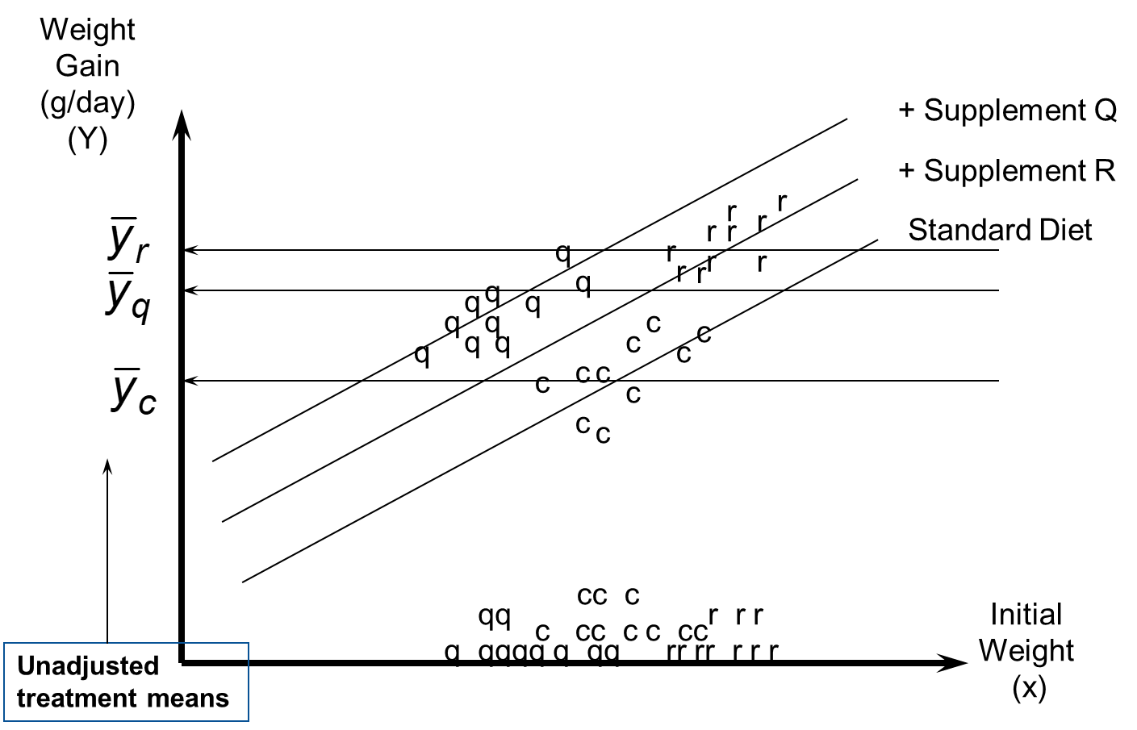
Unadjusted Group Means
Simple one-way classification ANOVA (without accounting for initial weight) gives us the wrong answer!

Slide 114
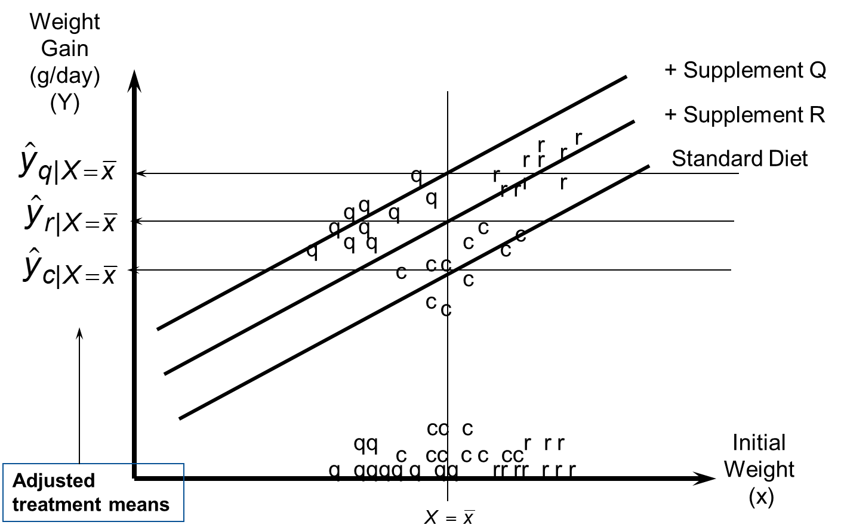
Adjusted Group Means
Expected weight gain is computed for treatments for average initial weight and comparisons are then made.

Slide 115
Logistic Regression

Slide 116
Logistic Regression
Special case of General Linear Model (GLM)
Outcome variable is binary or dichotomous
Independents can be categorical or continuous
Goal is to model probability of outcome as function of independent variable(s)
Probabilities are bounded between 0 and 1
Slope coefficient has relationship with odds ratio
Models log odds(Y) instead of outcome (Y) directly
Can use to quantify association between outcome and independent variables

Slide 117
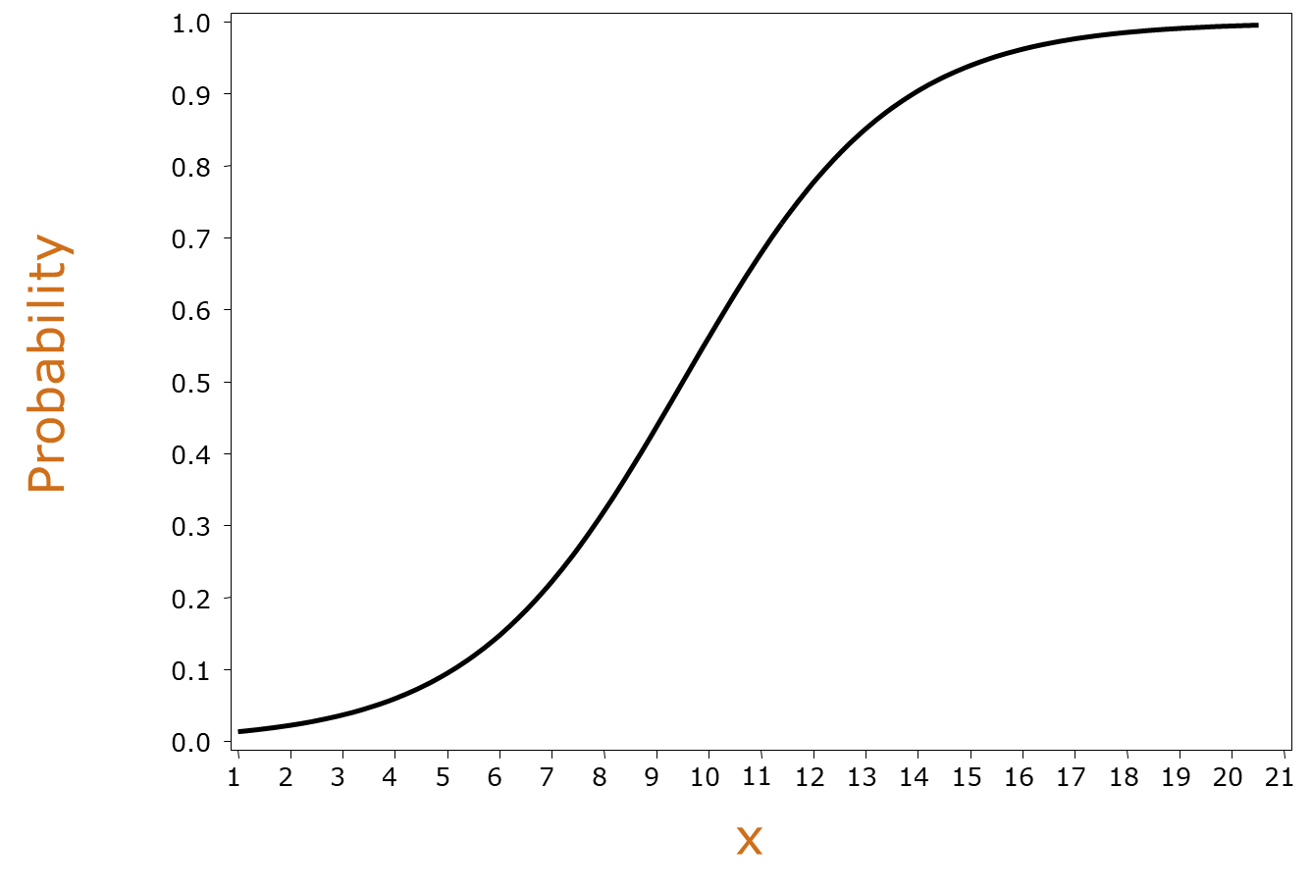
Logistic Regression Curve
Cannot use linear regression for dichotomous outcomes
Violates the linear regression assumptions (homoscedasticity)
Will end up with predicted Y’s other than 0 or 1 (possibly more extreme than 0 or 1).

Slide 118
Assumption
p_{i}
(p_{i} )
Logistic regression models transform probabilities called logits.
where i = indexes all cases (observations),
p_{i} = probability event occurs in i^{th} case.

Slide 119
Logistic Regression Model
is log(odds) of outcome.

Slide 120
Logistic Regression Model
dichotomous outcome
predictor variables
is log(odds) of outcome.

Slide 121
Logistic Regression Model
intercept
model coefficients
is log(odds) of outcome.

Slide 122
Model with Continuous Independent Variable
logit (p_{i}) = log (odds) = β₀ + β₁X₁
where logit(p_{i}) = logit transformation of probability of event
β₀ = intercept of regression line
β₁ = slope of regression line
Sign (±) of β determines whether log odds of y is increasing or decreasing for every 1-unit increase in x.
If β > 0, increase in log odds of y for every 1-unit increase in x.
If β < 0, decrease in log odds of y for every 1-unit increase in x.
If β = 0, no linear relationship between log odds and x.

Slide 123
Model with Categorical Independent Variable
logit (p_{i}) = log (odds) = β₀ + β_{k}X_{k}
Where logit(p_{i}) = logit transformation of probability of event
β₀ = intercept of regression line
β_{k} = difference between logits for category k vs. reference category
Need to specify a reference category (if more than 2 categories).
If reference group is 0, then coefficient of β_{k} represents difference in log odds between level k of variable and level 0.
e^{β} is odds ratio for category k vs. reference category of x.

Slide 124
Maximum Likelihood Estimation
Maximum likelihood estimation chooses values for parameter estimates which make observed data “maximally likely.”
ML estimators have great properties:
Unbiased (estimate true β’s)
Asymptotically efficient (narrow CI’s)
Asymptotically Normally distributed

Slide 125
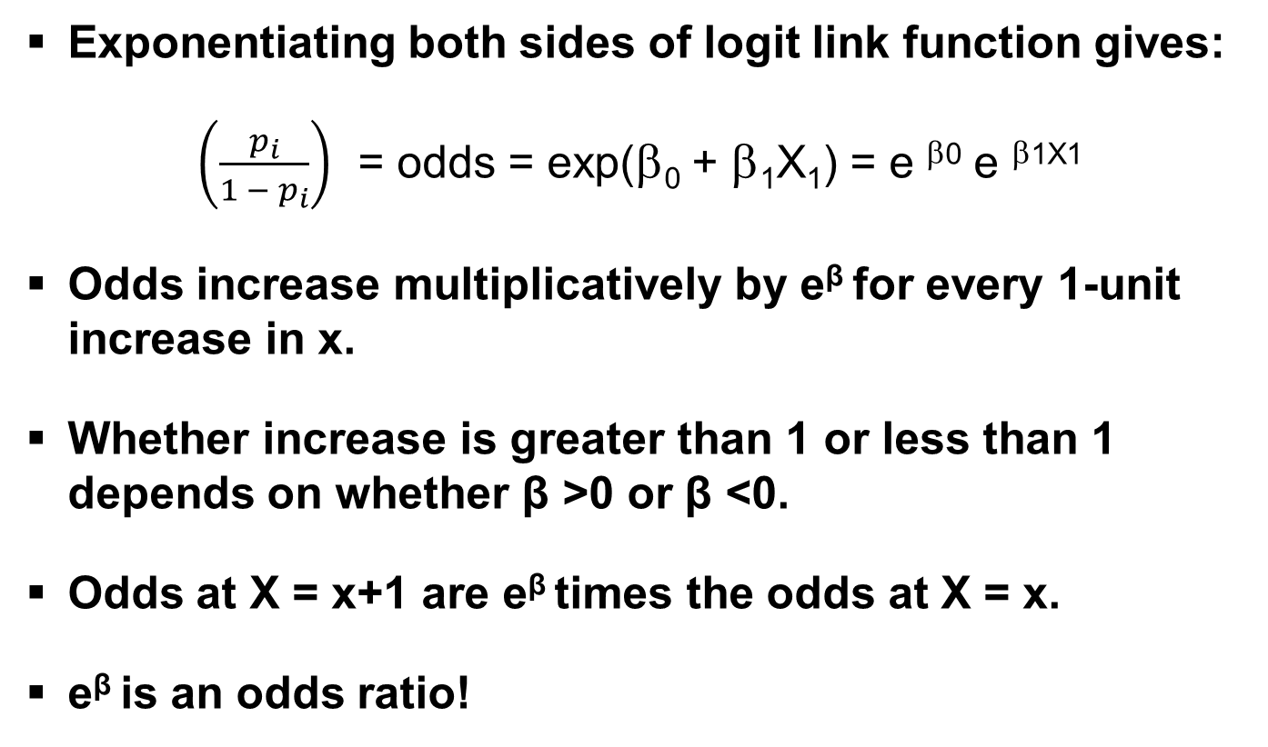
Interpreting Parameters
Exponentiating both sides of logit link function gives:
$\left(\frac{p_{i}}{1 − p_{i}}\right)$ = odds = exp(β₀ + β₁X₁) = e ^{β0} e ^{β1X1}
Odds increase multiplicatively by e^{β} for every 1-unit increase in x.
Whether increase is greater than 1 or less than 1 depends on whether β >0 or β <0.
Odds at X = x+1 are e^{β} times the odds at X = x.
e^{β} is an odds ratio!

Slide 126
Odds Ratio
In linear regression, slope coefficient is change in mean response as x increases by 1 unit
In logistic regression, e^{β} represents change in odds of outcome (multiplicatively) by increasing x by 1 unit
If β = 0, odds and probability are same at all x levels (e^{β} =1)
If β > 0, odds and probability increase as x increases (e^{β} >1)
If β < 0, odds and probability decrease as x increases (e^{β} <1)

Slide 127
95% Confidence Interval for Odds Ratio
Step 1: Construct a 95% CI for β :
Step 2: Raise e to get lower and upper bounds of CI:
If entire interval above 1, conclude positive association
If entire interval below 1, conclude negative association
If interval contains 1, cannot conclude an association

Slide 128
Hypothesis testing
Usually interested in testing
Wald test
Likelihood Ratio test

Slide 129
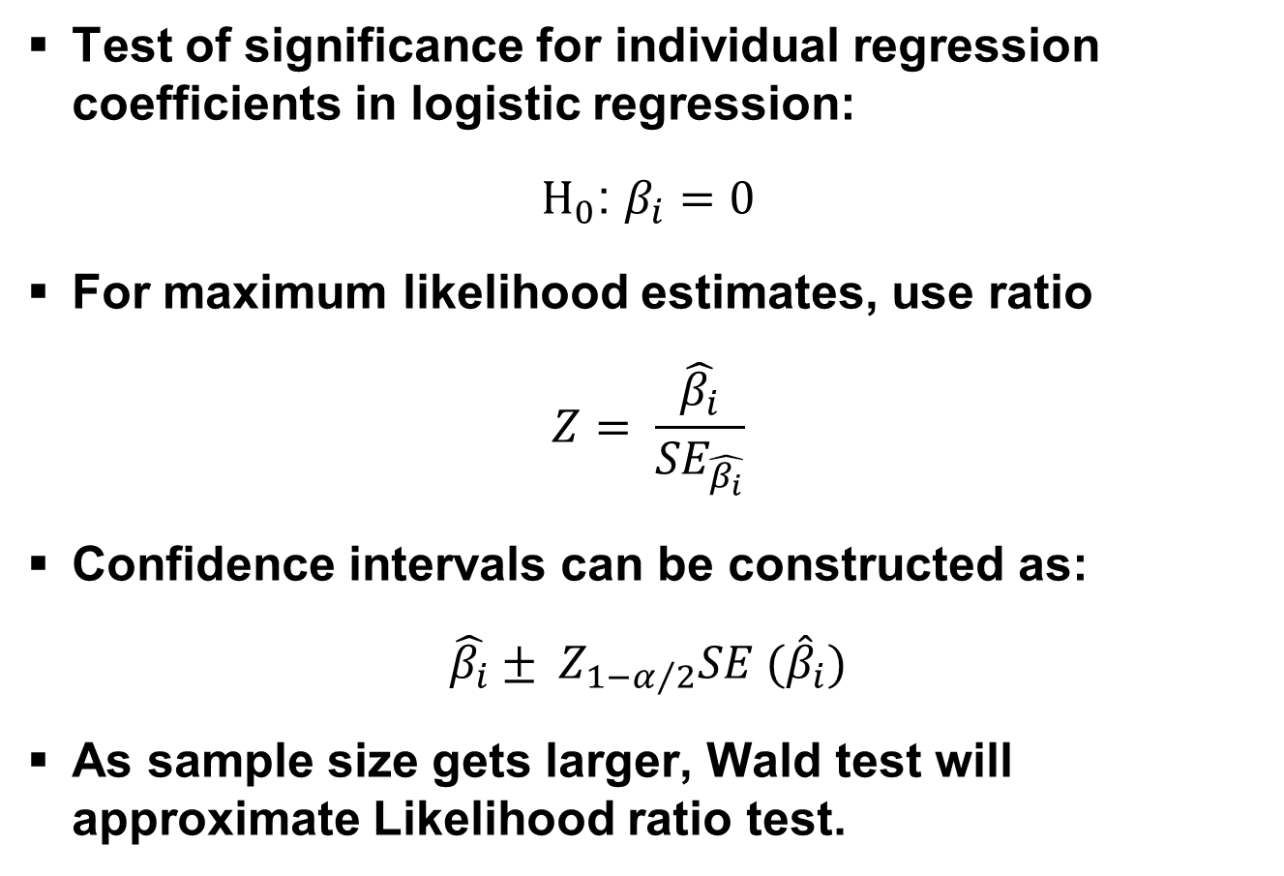
Wald Test
Test of significance for individual regression coefficients in logistic regression:
$H_{0}$: $β_{i}=0$
For maximum likelihood estimates, use ratio
$$Z= \frac{\hat{β_{i}}}{{SE}_{\hat{β_{i}}}}$$
Confidence intervals can be constructed as:
$$\hat{β_{i}}± Z_{1−α/2}SE ({\hat{β}}_{i})$$
As sample size gets larger, Wald test will approximate Likelihood ratio test.

Slide 130
Likelihood Ratio Test
Tests null hypothesis that any subset of β's is equal to 0.
Analagous to general linear F test for multiple linear regression.
Compare (log) Likelihood of two models
Full model = with predictor included
Reduced model = without predictor
Note: when testing single coefficient, Wald test and likelihood ratio test will not in general give identical results.

Slide 131
Likelihood Ratio Test
Compares two models
Log(odds) = α + β₁x₁ + β₂x₂ + β₃x₃ (model 1)
Log(odds) = α + β₁x₁ + β₂x₂ (model 2)
LR statistic

Slide 132
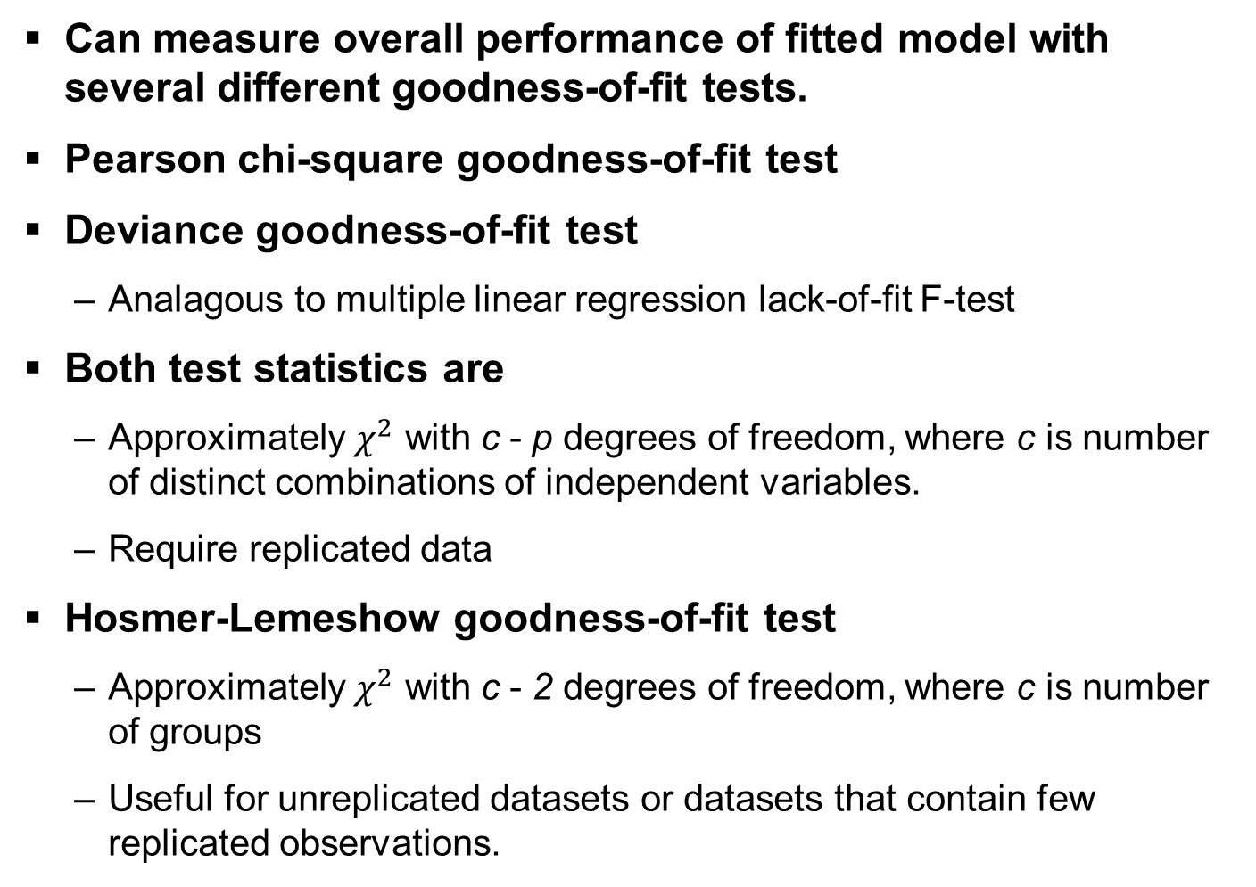
Goodness of Fit
Can measure overall performance of fitted model with several different goodness-of-fit tests.
Pearson chi-square goodness-of-fit test
Deviance goodness-of-fit test
Analagous to multiple linear regression lack-of-fit F-test
Both test statistics are
Approximately $χ^{2}$ with c - p degrees of freedom, where c is number of distinct combinations of independent variables.
Require replicated data
Hosmer-Lemeshow goodness-of-fit test
Approximately $χ^{2}$ with c - 2 degrees of freedom, where c is number of groups
Useful for unreplicated datasets or datasets that contain few replicated observations.

Slide 133
Multiple Logistic Regression
Extension to more than one predictor variable (either numeric or dummy variables).
With k predictors, model is written:
Adjusted Odds ratio for raising x_{i} by 1 unit, holding all other predictors constant:
Many models have nominal/ordinal predictors, and widely make use of dummy variables

Slide 134
Testing Regression Coefficients
Testing the overall model:
L₀, L₁ are values of maximized likelihood function.

Slide 135
Assumptions in logistic regression
Y_{i} are from Bernoulli or binomial (n_{i}, m_{i}) distribution
Y_{i} are independent
Log odds P(Y_{i} = 1) or logit P(Y_{i} = 1) is a linear function of covariates

Slide 136
proc logistic Syntax
proc logistic <options>;
model response = effects </options>;
class variables;
by variables;
output <out=name> <keyword=name>;
run;

Slide 137
Options
descending option
Causes levels of response variable to be sorted from highest to lowest
By default, SAS models probability of lower category
Class statement
Generates test of significance for all parameters associated with class variable
Specify dummy coding by using param = ref option

Slide 138
Example
Characteristic | Overall |  |  | FB₁ Intake Levelª
 |  |  |  | No/Low (n = 554) |  |  | High (n = 221) |  |  | p-value^{c}
 | Mean | SD^{b} | Median | Mean | SD^{b} | Median | Mean | SD^{b} | Median
Estimated FB₁ Intake | 2.41 | 6.75 | 0.34 | 0.34 | 0.57 | 0 | 7.61 | 11.03 | 4.64
Maize and maize atole, g | 2533.11 | 1506.74 | 2390 | 2346.59 | 1454.89 | 2240 | 3000.69 | 1536.03 | 2803 | <0.001
Tamales, g | 234.11 | 375.77 | 165 | 232.26 | 393.15 | 150 | 238.75 | 328.97 | 165 | 0.829
Beans, g | 644.93 | 1273.28 | 460 | 650.05 | 1411.17 | 345 | 632.10 | 835.40 | 460 | 0.859
Rice, g | 312.17 | 412.64 | 230 | 315.55 | 430.42 | 230 | 303.69 | 365.08 | 230 | 0.718
Bread, g | 571.36 | 547.70 | 430 | 593.57 | 529.73 | 490 | 515.68 | 587.93 | 370 | 0.075
Breakfast cereals, g | 90.04 | 114.39 | 20 | 88.89 | 133.04 | 34 | 92.94 | 169.84 | 0 | 0.725
Milk, Dairy, Eggs, g | 632.06 | 829.03 | 371 | 663.25 | 890.67 | 393.5 | 553.87 | 644.50 | 296 | 0.096
Meat, beef and pork, g | 73.81 | 830.90 | 0 | 86.34 | 979.79 | 0 | 42.41 | 120.34 | 0 | 0.708
Chicken and turkey, g | 241.99 | 231.65 | 230 | 242.42 | 219.82 | 230 | 240.90 | 259.46 | 202 | 0.935
Fish and shellfish, g | 33.88 | 103.68 | 0 | 34.77 | 108.31 | 0 | 31.64 | 91.24 | 0 | 0.704
Green leaves, g | 107.97 | 167.10 | 65 | 110.25 | 180.96 | 65 | 102.26 | 125.98 | 65 | 0.548
Green and yellow vegetables, g | 147.54 | 195.81 | 80 | 145.17 | 186.86 | 80 | 153.48 | 216.97 | 80 | 0.594
Other vegatables, g | 421.82 | 1697.77 | 211 | 368.67 | 1351.46 | 210 | 555.07 | 2350.51 | 230 | 0.188
Fruit, g | 646.92 | 851.92 | 420 | 670.78 | 920.84 | 420 | 587.09 | 645.70 | 420 | 0.220
Fats and oils, g | 127.63 | 855.89 | 48 | 107.65 | 263.83 | 53 | 177.70 | 1548.79 | 45 | 0.371
Sugar, g | 320.80 | 856.09 | 230 | 333.63 | 1000.96 | 230 | 288.63 | 241.93 | 230 | 0.567
Beverages, g | 91.11 | 182.14 | 0 | 90.38 | 182.00 | 0 | 92.94 | 182.91 | 0 | 0.859
Snacks, g | 52.25 | 124.58 | 0 | 54.69 | 134.89 | 0 | 46.15 | 93.92 | 0 | 0.393
Other mixed dishes, g | 6.03 | 28.15 | 0 | 5.76 | 30.26 | 0 | 6.68 | 22.03 | 0 | 0.6831
Maize-based food, g | 3021.10 | 1654.34 | 2793.5 | 2835.76 | 1620.01 | 2620 | 3478.14 | 1652.96 | 3215 | <0.001
Total folate, g | 3781.66 | 3306.95 | 3096 | 3806.32 | 3335.89 | 3176.25 | 3720.59 | 3240.89 | 2977.75 | 0.699
Total folic, g | 10.38.01 | 1337.74 | 754.75 | 1038.30 | 1474.58 | 735 | 1037.28 | 914.59 | 808.25 | 0.728
Total food, g | 7412.05 | 4037.97 | 6654.5 | 7290.70 | 4090.40 | 6462.5 | 7711.50 | 3898.69 | 6995.5 | 0.065
Number of food types consumed | 20.99 | 5.93 | 20 | 21.08 | 5.87 | 21 | 20.75 | 6.09 | 20 | 0.484
Number of maize-based food types consumed | 4.87 | 2.31 | 4 | 4.90 | 2.31 | 5 | 4.77 | 2.31 | 4 | 0.476
Percent of maize-based foods | 41.85 | 15.99 | 42.04 | 39.77 | 15.61 | 39.56 | 46.98 | 15.82 | 49.18 | <0.001
ª low/no (< 2 ug/kg body weight), and high (≥2 ug/kg body weight) ^{b} SD = standard deviation ^{c} P-value from bivariate logistic regression analysis

Slide 139
Example
%macro cat_univariate(depend_var,indep_var);
proc logistic data=&dset descending;
class &indep_var;
model &depend_var = &indep_var;
ods output ModelANOVA=&indep_var._chi;
ods output OddsRatios=&indep_var._or;
title2 "Univariate analysis for &indep_var";
run;
%mend;
%cat_univariate(fblevel2,DEPA); *department;
%cat_univariate(fblevel2,MUNI); *municipality;
%cat_univariate(fblevel2,eth); *ethnicity;
%cat_univariate(fblevel2,idioma); *language;
%cat_univariate(fblevel2,repwagecat); *age group;
%cat_univariate(fblevel2,amacasa); *occupation;
%cat_univariate(fblevel2,cantper1); *household size;
%cat_univariate(fblevel2,educamnew); *education;

Slide 140
Example
%macro cont_univariate(depend_var,indep_var);
proc logistic data=&dset descending;
model &depend_var = &indep_var;
ods output ParameterEstimates=&indep_var._chi;
ods output OddsRatios=&indep_var._or;
title2 "Univariate analysis for &indep_var";
run;
Proc print data=&indep_var._chi; run;
%mend;
%cont_univariate(fblevel2,CANTALIM); *number foods consumed;
%cont_univariate(fblevel2,CANTMAIZ); *number maize-based foods consumed;
%cont_univariate(fblevel2,GRAMMAIZ); *grams of maize consumed;
%cont_univariate(fblevel2,GRAMTOTA); *grams of total food consumed;
%cont_univariate(fblevel2,RAZOMAIZ); *proportion of total food maize-based;

Slide 141
Output

Slide 142
Adding a Covariate
proc logistic data=cohort descending plots(only)=oddsratio;
class repwagecat;
model fblevel2 = repwagecat razomaiz;
oddsratio repwagecat;
ods output ModelANOVA=age_razo_chi;
ods output OddsRatios=age_razo_or;
title2 "Univariate analysis for Age Group and Razomaiz";
run;

Slide 143
Output

Slide 144
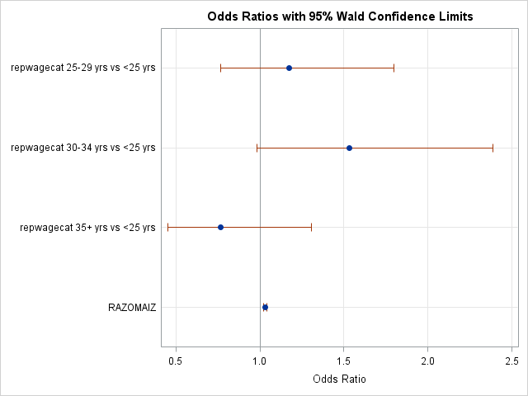
Output

Slide 145
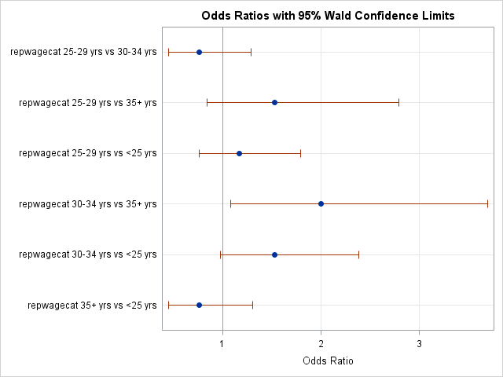
Output

Slide 146
Regression for Count Data

Slide 147
Count Variables
Many dependent variables are counts
# Children living in a household
# new companies founded in a year (in an industry)
# of crimes per month in a city
# of pathogen cells found in a food
# of visits to dentist in a year
# of speeding tickets received in a year
Underlying variable is discrete and non-negative
In many cases the count is 0 for several observations.
Count variables can be modeled with linear regression but…
Linear models can yield negative predicted values but counts are not negative
Count variables are often highly skewed
Extreme skewness violates normality assumption

Slide 148
Count Models
Two most common count models:
Poisson Regression Model
Negative Binomial Regression Model
Both based on Poisson distribution:
λ = expected count (and variance)
y = observed count

Slide 149
Poisson Regression

Slide 150
Poisson Distribution
If discrete random variable Y follows Poisson distribution, probability density function (PDF) is given by:
where f(Y|y_{i}) denotes probability that discrete random variable Y takes non-negative integer value y_{i} and λ is parameter of Poisson distribution.
Equidispersion: A unique feature of Poisson distribution is that mean and variance are the same
If variance > mean, there is overdispersion

Slide 151
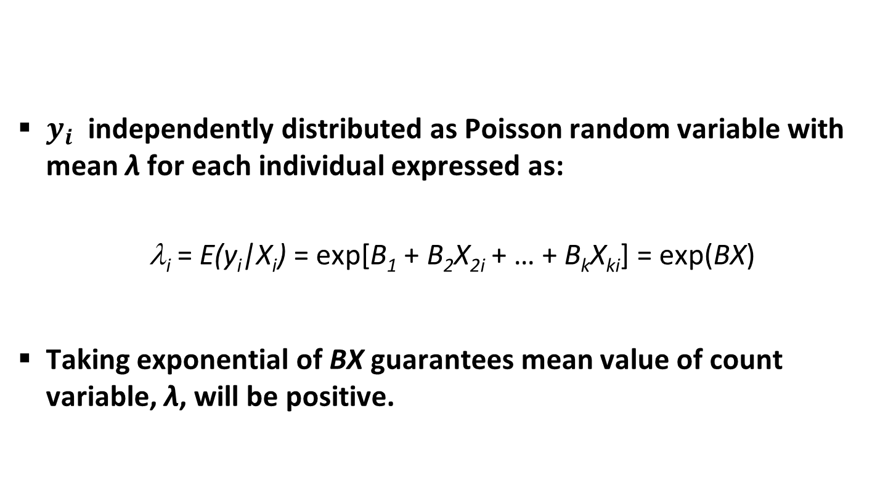
Poisson Regression Model
$y_{i}$ independently distributed as Poisson random variable with mean λ for each individual expressed as:
λ_{i} = E(y_{i}|X_{i}) = exp[B₁ + B₂X_{2i} + … + B_{k}X_{ki}] = exp(BX)
Taking exponential of BX guarantees mean value of count variable, λ, will be positive.

Slide 152
Interpreting Coefficients
Y is typically conceptualized as a rate…
Positive coefficients indicate higher rate; negative = lower rate
Exponentiated coefficients (rate ratios) indicate effect of unit change of X on rate
e^{b}= 2.0 indicates rate doubles for each unit change in X
e^{b}= .5 indicates rate drops by half for each unit change in X
Exponentiated coefficients are multiplicative
If e^{b}= 5.0, a 2-point change in X isn’t 10; it is 5 * 5 = 25
If e^{b}= 5.0, a 1-point decrease in X isn’t -5, it is 1/5 = .2
Can convert exponentiated coefficients to % change
Formula: (e^{b} - 1) * 100%
Ex: Coefficent = -.693
(e^{-.693} - 1) * 100% = 50% decrease in rate.

Slide 153
Poisson Model Assumptions
Equidispersion
Mean and variance are the same
Assumption often not met in real data
Overdispersion: variance is larger than mean
Can be caused by violating assumption of independence.
Consequence of overdispersion:
Standard errors will be underestimated (too small!)
Potential overconfidence in results; reject H₀ when shouldn’t!
Overdispersion is most often caused by highly skewed dependent variables

Slide 154
Testing for Equidispersion
Estimate Poisson regression model and obtain predicted value of Y.
Subtract predicted value from observed value of Y to obtain residuals
Square residuals and subtract from observed value
Regress results on predicted value of Y squared.
If slope coefficient is statistically significant, reject assumption of equidispersion (and Poisson model).
If regression coefficient is positive and statistically significant, there is overdispersion.
If regression coefficient is negative, there is under-dispersion.

Slide 155
Dealing with Overdispersion

Slide 156
Negative Binomial Regression
Can modify Poisson model to address overdispersion by adding “error” term
Response has Poisson distribution with rate λ
λ has Gamma distribution across population
At population level, dependent variable has negative binomial distribution
Assumptions
Expected value of exponentiated error = 1 (e^{e} = 1)
Exponentiated error is Gamma distributed

Slide 157
Negative Binomial Distribution
where σ² = variance, μ = mean, r = model parameter
Variance always larger than mean.
More suitable to count data than Poisson.
As r → ∞ and probability of success (p) → 1, approaches Poisson distribution, assuming mean μ stays constant.

Slide 158
Negative Binomial Model
α represents extent of overdispersion
If α = 0, model reduces to poisson regression
If not, overdispersion is present; Poisson is inadequate
Test hypothesis: H₀: α = 0 vs H₁: α > 0
Likelihood ratio test (G²) for alpha
P-value < .05 indicates overdispersion
If P >.05, use Poisson regression
Interpret regression coefficients as in Poisson

Slide 159
General Remarks
Poisson and negative binomial models suffer same basic issues as “normal” regression
Model specification / omitted variable bias
Multicollinearity
Outliers/influential cases
Both use Maximum Likelihood
N > 500 = fine; N < 100 can be worrisome
Plus ~10 cases per independent variable.
Useful to Poisson and Negative Binomial models
Poisson has fewer assumptions so better if equidispersion
Negative Binomial tests for overdispersion

Slide 160
Zero-Inflated Models
Sometimes have lots of zeros and negative binomial isn’t sufficient
Highly skewed
Model under-predicts zeros, doesn’t fit well
Zero-inflated models assume two types of group in sample
Always zero – no probability of non-zero value
Non-zero chance of positive count
Models
Zero-inflated Poisson
Zero-inflated Negative Binomial
Zero-truncated Poisson
Zero-truncated Negative Binomial

Slide 161
proc genmod
Implements generalized linear model
Can fit models with normal, binomial or poisson response variable (among others)
Can fit generalized estimating equations for repeated measures data

Slide 162
proc genmod Syntax
proc genmod <options>;
by variables;
class variables;
model response = effects </options>;
output <out=name> <keyword=name>;
make ‘table’ out=name;
run;

Slide 163
Example
Dilution assays are used to estimate density of particles of bacteria, viruses and fungi
λ is density of particles by unit volume in initial solution
Vi = volume of i-th dilution (amount of original suspension)
Yi,j = number of particles from i-th dilution, j-th replicate
Yij ∼ P(λvi) µij = λvi ⇒ log(µij ) = log λ + log(vi)
⇒ log(µij ) = β + offset
λˆ = exp(βˆ)
Confidence interval for λ is exp[βˆ ∓ 1.96s.e.(βˆ)]

Slide 164
Example
Aim is to estimate number of virus particles per unit volume (Ridout, 1990).
Data are counts of virus particles at 5 different dilutions.
4 replicate counts at each dilution except last which has 5 counts.
Dilution Counts
0.3162 13 14 17 22
0.1778 9 14 6 14
0.1000 4 4 3 5
0.0562 3 2 1 3
0.0316 2 1 3 2 2

Slide 165
Example
data dilution;
input dilution count @@;
cards;
0.3162 13 0.3162 14 0.3162 17 0.3162 22
0.1778 9 0.1778 14 0.1778 6 0.1778 14
0.1000 4 0.1000 4 0.1000 3 0.1000 5
0.0562 3 0.0562 2 0.0562 1 0.0562 3
0.0316 2 0.0316 1 0.0316 3 0.0316 2 0.0316 2
;
run;
proc univariate data = dilution noprint;
histogram count;
run;
proc genmod data=dilution;
model count=dilution/dist=poisson;
run;
proc genmod data=dilution;
model count=dilution/dist=negbin;
run;

Slide 166
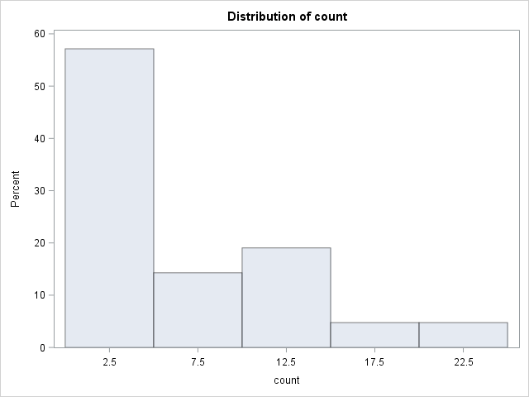
Output

Slide 167
Output

Slide 168
Missing Data

Slide 169

Missing Data
All studies have missing data
Failing to adjust for missing data can cause serious problems.
Introduces potential bias in parameter estimation
Weakens generalizability of results
Ignoring cases with missing data leads to loss of information
Decreases statistical power
Increases standard errors
Failing to adjust data properly for missing values can make data unsuitable for statistical procedure
Can also make statistical analyses vulnerable to violations of assumptions

Slide 170
Reasons for Missing Data
Due to preventable errors, mistakes, or lack of foresight by the researcher
Due to problems outside the control of the researcher
Deliberate, intended, or planned by the researcher to reduce cost or respondent burden
Due to differential applicability of some items to subsets of respondents
Etc.
Participants can fail to respond to questions
equipment and data collecting or recording mechanisms can malfunction,
subjects can withdraw from studies before they are completed, and
data entry errors can occur.

Slide 171
Types of Missing Data
Missing completely at random (MCAR): probability of missingness is independent of the data.
Missing at random (MAR): probability of missingness depends only on observed data.
Nonmissing at random (NMAR): probability of missingness may also depend on unobservable part of data.
Non-ignorable
Difficult to deal with

Slide 172
Dealing with Missing Data
Identify patterns/reasons for missing (aka understand your data)
Attrition due to social/natural processes
Skip patterns
Intentional missing as part of data collection process
Respondent refusal/Non-response
Observations are not sampled with the same frequency.
Are certain groups more likely to have missing values?
Are certain responses more likely to be missing?
Decide on best method of analysis
Make inference about distribution parameter of “full” data when some of data are missing

Slide 173
Methods of Analysis
Traditional approaches
Delete observations with incomplete data
Imputation methods
Random sample from existing values
Randomly sample from a reasonable distribution
Mean/Mode substitution
Dummy variable adjustment
Regression substitution
Maximum Likelihood Estimation
Advanced approaches
Maximum Likelihood method (ML)
Weighing method (IPW)
Multiple imputation method (MI)

Slide 174
Example
***************************************************************;
title "Univariate Analysis with missing data imputed as median";
***************************************************************;
%macro impute;
proc univariate data=cohort noprint;
var G1--G61;
output out=g_medians median= %do i=1 %to 61; median_g&i %end;;
run;
proc print data=g_medians; run;
data cohort;
merge cohort g_medians;
%do j=1 %to 61;
if impute=1 then g&j=median_g&j;
%end;
run;
proc freq data=cohort; table impute; run;
%mend;
%impute;

Slide 175

Questions?

Slide 176
Multiple Regression

Slide 177
Multiple Regression
Extension of simple linear regression (one dependent and one independent variable)
Examine linear relationship between dependent and two or more independent variables
Estimate impact of relationship of independent variables (X’s) collectively and individually on dependent variable (Y).
Effect of other variables is removed (controlled for) when assessing relationships
If set up properly, can be used to analyze data from:
One-way ANOVA
Randomized block
Factorial designs

Slide 178
Multiple Regression Model
Y-intercept
Population slopes
Random Error
One dependent variable and k independent variables
Each new variable is new term in model
Independent variables can be categorical or continuous
Categorical variables need to be coded as binary dummy variables
Partial regression coefficients: β_{i} ≡ effect (on the mean response) of increasing i^{th} predictor variable by 1 unit, holding all other predictors constant

Slide 179
Multiple Regression Equation
Estimated
(or predicted)
value of Y
Estimated
intercept
Estimated slope coefficients
ŷ_{i} represents regression estimate of dependent variable for ith member of sample and b’s are estimates of β’s (coefficients).
Coefficients of multiple regression model are estimated using sample data.

Slide 180
Indicator Variables
Categorical data must be coded so that they can be handled as independent variables in the model.
“Indicator” variables provide mechanism for including categories into analyses using multiple regression techniques.
Use coding scheme: x₁ = 1 if condition met
= 0 otherwise
Treatment | X₁ | X₂
A | 1 | 0
B | 0 | 1
C | 0 | 0

Slide 181
Fixed vs Random Effects
Fixed Effects: concrete
e.g. sex, age
Random Effects: representative sample
e.g. treatments, locations, tests
Mixed Effects: combination of fixed and random

Slide 182
Bivariate Model
Y
Sample observation
Y_{i}
Residual =
e_{i} = (Y_{i} – Y_{i})
<
Y_{i}
x_{2i}
X₂
x_{1i}
X₁

Slide 183
Developing the Model
Specify model and estimate all unknown parameters
Evaluate model
Examine variation measures
Test Significance of overall model, portions of overall model and individual coefficients
Check conditions of multiple linear regression model using residuals
Assess multicollinearity
Use model for estimation and prediction

Slide 184
Over-fitting and Under-fitting Models
Over-fitting – too many variables in model, including some unrelated to response
Fitted model is not good for prediction of new data – prediction error is underestimated
Model too elaborate, models “noise” will not be same for new data
Variances of regression coefficients inflated
Under-fitting – too few variables in model, leaving out variables that could help explain response
Fitted model is not good for prediction of new data – prediction is biased
Regression coefficients are biased
Estimate of error variance is too large
Rule of thumb: Need at least 10 subjects for each additional predictor variable in model.

Slide 185
Variation Measures
Coefficient of Multiple Determination – proportion of variation in Y ‘explained’ by all X variables taken together
Adjusted R² – proportion of variation in Y explained by all X variables adjusted for number of X variables used
R² never decreases when new X variable added to model so need to adjust
Penalizes excessive use of unimportant independent variables
Smaller than r²

Slide 186
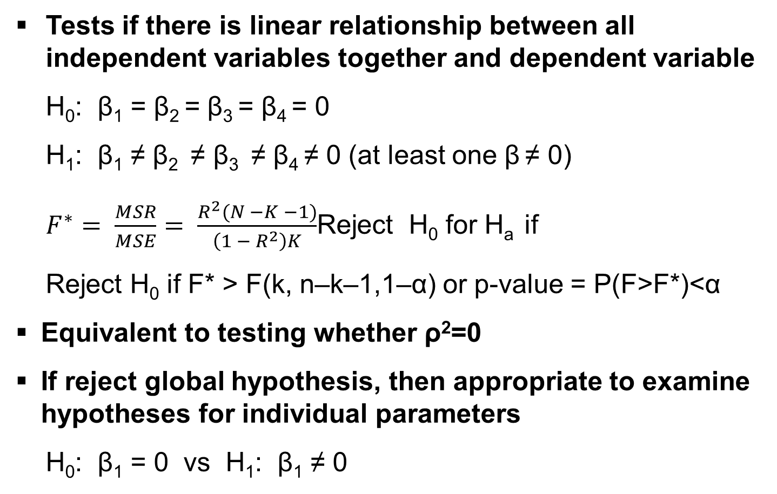
Global Hypothesis
Tests if there is linear relationship between all independent variables together and dependent variable
H₀: β₁ = β₂ = β₃ = β₄ = 0
H₁: β₁ ≠ β₂ ≠ β₃ ≠ β₄ ≠ 0 (at least one β ≠ 0)
$F^{∗}= \frac{MSR}{MSE}= \frac{R^{2}(N −K −1)}{\left(1 − R^{2}\right)K}$Reject H₀ for H_{a} if
Reject H₀ if F* > F(k, n–k–1,1–α) or p-value = P(F>F*)<α
Equivalent to testing whether ρ²=0
If reject global hypothesis, then appropriate to examine hypotheses for individual parameters
H₀: β₁ = 0 vs H₁: β₁ ≠ 0

Slide 187
Types of Sums of Squares
Type I – sequential sums of squares
Incremental improvement in SSE as each effect is added to model
Computed as decrease in SSE when effect is added to model
Depends on order of effects in model
Type II – hierarchical sums of squares
Reduction in SSE due to adding term after all other terms have been added to model
Invariant to ordering of effects in model
Type III – partial (or marginal) sums of squares
Usually most desirable
SS adjusted for all other effects in model
Invariant to ordering of effects in model
Type IV – balanced sums of squares
Variation of Type III but for designs with missing cells

Slide 188
Assumptions
Linear functional relationship
Normality of residuals
Mean of Distribution of Error Is 0
Distribution of Error is Normal
Homoscedasticity of residual variance
Constant variances for errors
Independence
No autocorrelation (residuals are correlated)
No multicollinearity (independent variables are correlated, r>0.8)
No outliers

Slide 189
Tips on Fitting Models
Always evaluate model fit
For empirical model selection, always choose model with fewest number of predictor variables
Parameters for each predictor should be significant in selected model
Don’t judge just using overall F-test
Can use ‘automated’ ways to find “best subsets” of predictors
Be cautious as methods can be misleading.
Use only as preliminary guides.

Slide 190
Interpreting Multiple Regression Coefficients
Interpretation similar to simple linear regression coefficient, except coefficient is adjusted for other terms in model.
Each regression coefficient is amount of change in outcome variable that would be expected per one-unit change of independent variable, if all other variables in model were held constant.
Example
Four independent variables
Coefficient for X₁ is b₁ = 0.084
For every unit increase in X₁, dependent variable goes up 0.084 units, adjusted for other three terms in model.

Slide 191
PROC REG
Estimates parameters by least squares
Produces diagnostics to test model fit (e.g. scatter plots)
Tests hypotheses
Example:
proc reg data=mydata;
model weight = height age;
run;

Slide 192
PROC REG Syntax
Syntax:
proc reg <options>;
model response = effects </options>;
plot yvariable*xvariable = ’symbol’;
by varlist;
output <OUT=SAS data set> <output statistic list>;
run;

Slide 193
PROC REG Syntax
proc reg statement syntax:
data = input data set
outest = creates data set with parameter estimates
simple prints simple statistics
model statement
model response=<effects></options>;
required
variables must be numeric
many options
can specify more than one model statement

Slide 194
PROC REG Syntax
plot statement
plot yvariable*xvariable <=symbol> </options>;
produces scatter plots - yvariable on the vertical axis and xvariable on the horizontal axis
can specify several plots
optional symbol to mark points
yvariable and xvariable can be variables specified in model statements or statistics available in output statement
output statement
output <OUT=SAS data set> keywords=names;
creates SAS data set
all original variables included
keyword=names specifies the statistics to include

Slide 195
PROC GLM (General Linear Model)
Uses least-squares with generalized inverses
Performs linear regression, analysis of variance, analysis of covariance
Accepts classification variables (discrete) and continuous variables
Estimates and performs tests for general linear effects
Can be used for balanced or unbalanced designs
PROC ANOVA is suitable for “balanced” designs
Suitable for random effects models

Slide 196
proc glm Syntax
proc glm data=name <options>;
class classification variables;
model response=effects /options;
means effects / options;
random effects / options;
estimate ‘label’ effect value / options;
contrast ‘label’ effect value / options;
run;

Slide 197
Fit Model and Obtain Residuals
Residuals are calculated by PROC GLM and can be output to SAS dataset.
PROC GLM DATA = response ;
CLASS treatment ;
MODEL response = treatment ;
OUTPUT OUT = resid RESIDUAL = e P=fitted ;
run ;
OUTPUT statement creates new dataset, called resid, containing original data and new variable, e (residuals)

Slide 198
Standardize Residuals
Use PROC STANDARD to standardize residuals
proc standard data = resid
out=stdresid (rename=(e=z)) std=1.0;
var e ;
run ;
Creates new dataset called stdresid, and standardized residuals are variable called z.

Slide 199
Plot Residuals
Several model assumptions can be checked by plotting standardized residuals versus independent variable.
proc gplot data = stdresid ;
plot z * treatment / vref = 0 ;
run;
Check for constant variance by plotting standardized residuals versus fitted values.
proc gplot data = stdresid ;
plot z * fitted / vref = 0 ;
run ;
Check for dependence of error terms by plotting standardized residuals versus order in which observations were obtained.
proc gplot data = stdresid ;
plot z * order / vref = 0 ;
run ;

Slide 200
Checking for Constant Variances
Use PROC MEANS to get standard deviations
PROC MEANS data = stdresid ;
CLASS treatment ;
VAR z ;
RUN ;
Output: treatment N Obs Std Dev
1 3 1.2139977
2 3 0.7283090
3 3 1.4610930
4 3 0.7707698
5 3 1.6798537
6 3 0.9721052

Slide 201
Normal Probability Plot
Use PROC UNIVARIATE
PROC UNIVARIATE DATA = stdresid plots ;
var z ;
probplot / normal (mu=0 sigma=1) square;
RUN ;

Slide 202
An Example
Data Example;
Input X Y @@;
Cards;
4.6 87.1 5.1 93.1 4.8 89.8 4.4 91.4 5.9 99.5
4.7 92.1 5.1 95.5 5.2 99.3 4.9 93.4 5.1 94.4
;
Run;
Proc GLM;
Model Y = X / solution;
Run;
Quit;

Slide 203
Output
Tests if model as whole counts for significant proportion of Y
R-square measures how much variation in Y that model accounts for
Solution option in model statement requests parameter estimates

Slide 204
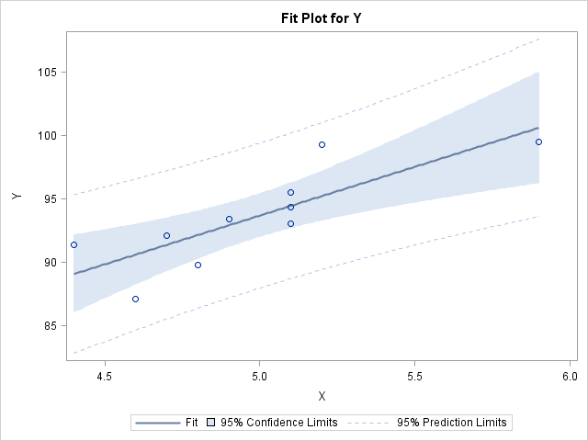
Output

Slide 205
Let’s Practice . . .
Pilot experiment is conducted to study oyster growth to:
Determine if exposure to artificially-heated water affects growth
Determine if position in water column (surface vs. bottom) affects growth
Twenty bags of ten oysters each were placed across 5 locations within cooling water runoff of power-generation plant (i.e. 4 bags / location).
Each location is considered a treatment:
TRT1: cool-bottom
TRT2: cool-surface
TRT3: hotbottom
TRT4: hot-surface
TRT5: control (i.e. mid-depth and mid-temperature).
Each bag of oysters is considered to be one experimental unit.
Oysters were cleaned and weighed at beginning of experiment and again one month later.

Slide 206
Data
Data Oyster;
Input Trt Rep Initial Final @@;
Cards;
1 1 27.2 32.6 1 2 32.0 36.6
1 3 33.0 37.7 1 4 26.8 31.0
2 1 28.6 33.8 2 2 26.8 31.7
2 3 26.5 30.7 2 4 26.8 30.4
3 1 28.6 35.2 3 2 22.4 29.1
3 3 23.2 28.9 3 4 24.4 30.2
4 1 29.3 35.0 4 2 21.8 27.0
4 3 30.3 36.4 4 4 24.3 30.5
5 1 20.4 24.6 5 2 19.6 23.4
5 3 25.1 30.3 5 4 18.1 21.8
;
Run;

Slide 207
Simple Overall Regression
Is there a linear relationship between the initial and final weights?
PROC GLM data=oyster;
Model Final = Initial;
Title “Simple Overall Regression”;
Run;

Slide 208
Results

Slide 209
Simple Regression within Treatment Level
Are the slopes consistent across treatment levels?
PROC SORT data=oyster;
By Trt;
run;
PROC GLM;
By TRT;
Model Final = Initial;
Title “Simple regression within treatment level”;
Run;

Slide 210
Results
Parameter | Estimate | Standard Error | T value | Pr > |t|
Slope(TRT1) | 0.982646773 | 0.10941830 | 8.98 | 0.0122
Slope(TRT2) | 1.501355014 | 0.39230860 | 3.83 | 0.0620
Slope(TRT3) | 1.056066579 | 0.12801209 | 8.25 | 0.0144
Slope(TRT4) | 1.056925032 | 0.06842649 | 15.45 | 0.0042
Slope(TRT5) | 1.223886048 | 0.02530981 | 48.36 | 0.0004

Slide 211
One-Way ANOVA
Does location does affect oyster growth?
How does the model fit?
PROC GLM data=oyster;
Class Trt;
Model Final = Trt;
Title “One-way ANOVA”;
Run;

Slide 212
Results

Slide 213
Results

Slide 214
ANCOVA
What is the effect of location on Final Weight, adjusting for differences in Initial Weight?
What are the adjusted treatment means for each pair of treatments? Do you get different results without the covariate in the analysis?
PROC GLM data=oyster Order = Data plot=meanplot(cl) diagnostics;
Class Trt;
Model Final = Trt Initial;
LSMeans Trt / pdiff;
Output out = OysterPR p = Pred r = Res;
Contrast 'Control vs. Treatment' TRT -1 -1 -1 -1 4;
Contrast 'Bottom vs. Top' TRT -1 1 -1 1 0;
Contrast 'Cool vs. Hot' TRT -1 -1 1 1 0;
Contrast 'Interaction Depth*Temp' TRT 1 -1 -1 1 0;
title “ANCOVA”;
Run;

Slide 215
Results

Slide 216
Results

Slide 217
Results

Slide 218
Results

Slide 219
Test for Independence of Treatments and Covariate
Need to test null hypothesis that there are no significant differences in X among treatment levels.
Only need to conduct test if covariate is measured after experiment is conducted
Expect to find no differences
PROC GLM data = oyster;
Class Trt;
Model Initial = Trt;
Title 'Test for independence of treatments and covariate (example only – not needed for this study)';
Run;

Slide 220
Results

Slide 221
Test for Heterogeneity of Slopes
ANCOVA assumes homogeneity of covariate regression coefficients.
A regression relationship that differs among treatment groups reflects interaction between treatment groups and independent variable or covariate.
Are the slopes homogeneous?
PROC GLM data=oyster;
Class Trt;
Model Final = Trt Initial Trt*Initial;
Title 'Test for homogeneity of slopes';
Run;

Slide 222
Results

Slide 223
Normality of Residuals
Are the residuals normally distributed?
PROC Univariate Data = OysterPR normal plot;
Var Res;
Title ‘Normality of Residuals’;
Run;
PROC Plot Data = OysterPR;
Plot Res*Pred = Trt;
Run;

Slide 224
Results

Slide 225
Homogeneity of Variances
Are the variances homogeneous?
data oyster;
set oyster;
Z = Final - 1.083179819*(Initial-25.76);
run;
PROC GLM data = oyster Order = Data;
Class Trt;
Model Z = Trt;
Output out = OysterPRz p = Pred r = Res;
Title 'ANOVA on Z';
Run;
PROC GLM data=oysterPRz;
Class Trt;
Model Z = Trt;
Means Trt / hovtest = Levene;
Title 'Homogeneity of variances';
Run;

Slide 226
Results

Slide 227
Ordinal Regression

Slide 228
Ordinal Logistic Regression
What if outcome variable has more than two levels?
Eg. Likert Scale
1 = strongly disagree
2 = disagree
3 = neutral
4 = agree
5 = strongly agree
For ordinal outcomes, use ordinal logistic regression:
Relies on cumulative logit
Models predicted probability of multiple outcomes
Also known as “proportional odds model”

Slide 229
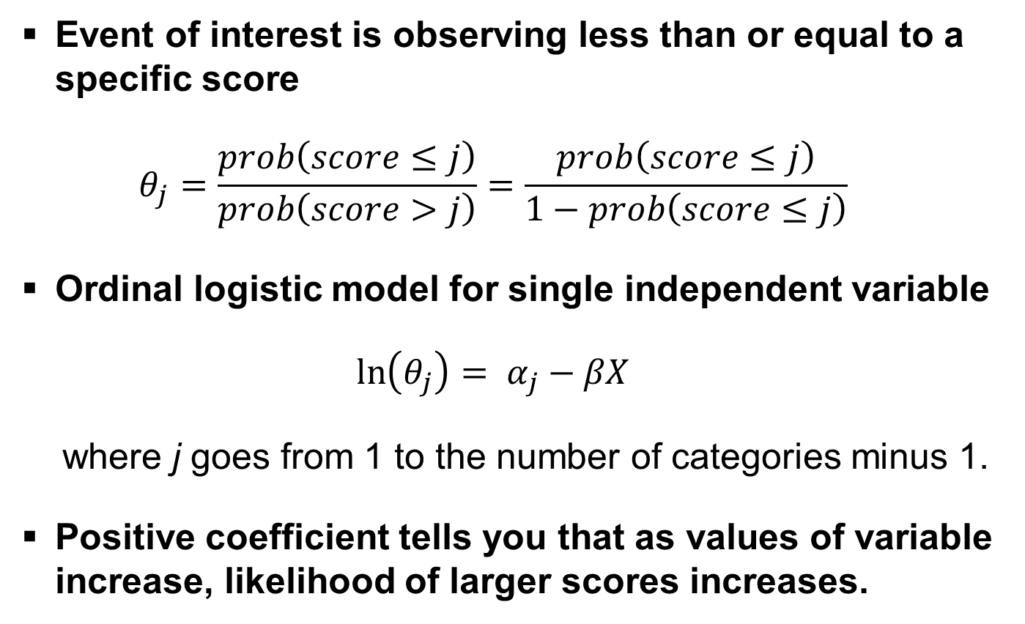
Ordinal Logistic Regression
Event of interest is observing less than or equal to a specific score
$$θ_{j}=\frac{prob\left(score≤j\right)}{prob\left(score>j\right)}=\frac{prob\left(score≤j\right)}{1−prob\left(score≤j\right)}$$
Ordinal logistic model for single independent variable
$$\ln\left(θ_{j}\right)= α_{j}−βX$$
where j goes from 1 to the number of categories minus 1.
Positive coefficient tells you that as values of variable increase, likelihood of larger scores increases.

Slide 230
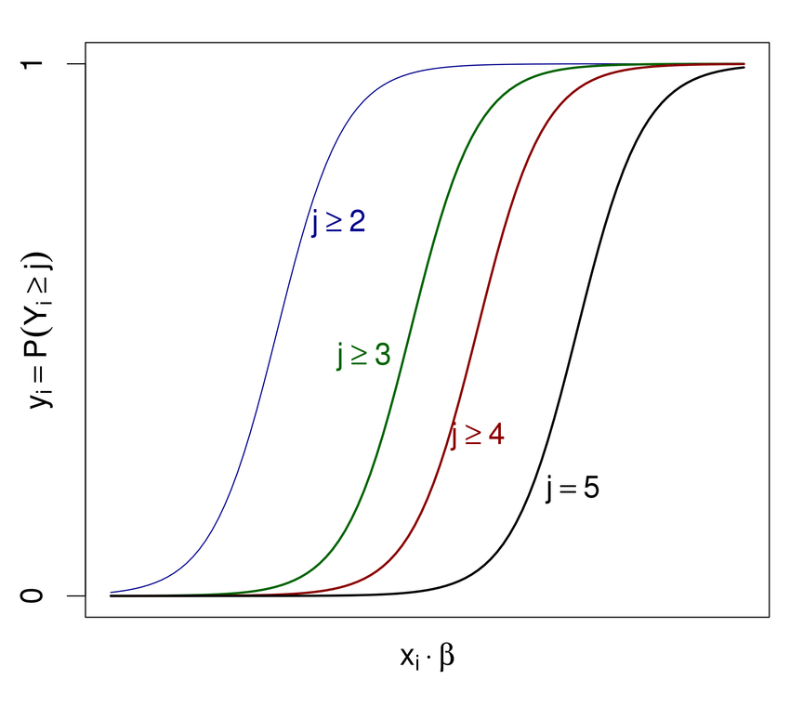
Advantages & Disadvantages
Better than running separate logistic models for different outcomes
Improves statistical power
Does not require turning ordinal variable into a binary variable
But does require that you meet proportional odds assumption…
Effects of any explanatory variables are consistent (proportional) across different thresholds

Slide 231
Example
Researchers tested four cheese additives and obtained 52 response ratings for each additive. Each response was measured on a scale of nine categories ranging from strong dislike (1) to excellent taste (9).
data Cheese;
do Additive = 1 to 4;
do y = 1 to 9;
input freq @@;
output;
end;
end;
label y='Taste Rating';
datalines;
0 0 1 7 8 8 19 8 1
6 9 12 11 7 6 1 0 0
1 1 6 8 23 7 5 1 0
0 0 0 1 3 7 14 16 11
;
ods graphics on;
proc logistic data=Cheese plots(only)=oddsratio(range=clip);
freq freq;
class Additive (param=ref ref='4');
model y=Additive / covb;
oddsratio Additive;
effectplot / individual polybar;
title 'Multiple Response Cheese Tasting Experiment';
run;
ods graphics off;

Slide 232
SAS Output

Slide 233
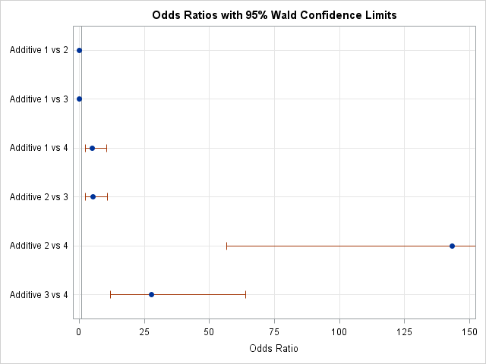
SAS Output

Slide 234
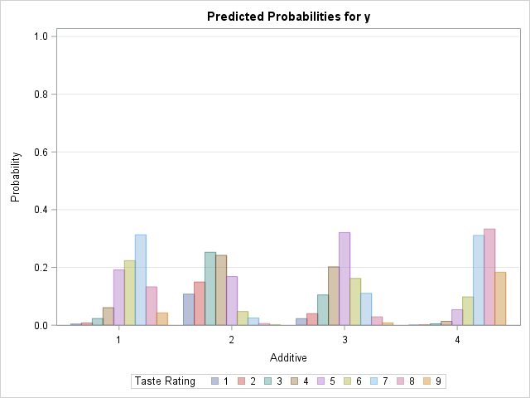
SAS Output

Slide 235
Multivariate Analysis

Slide 236
Multivariate Analysis
Used for analyzing more than two dependent variables at once
Typically more than one measurement is taken on a given experimental unit
Need to consider all the measurements together so that one can understand how they are related
Need to consider all the measurements together so that one can extract essential structure

Slide 237
Multivariate Analysis Methods
Principal Components Analysis (PCA)
Factor Analysis (FA)
Discriminant Analysis (DA)
Multidimensional Scaling (MDS)
Cluster Analysis (CA)
Canonical Correlations Analysis (CCA)
Multivariate Analysis of Variance (MANOVA)
Structural Equation Modeling (SEM)

Slide 238
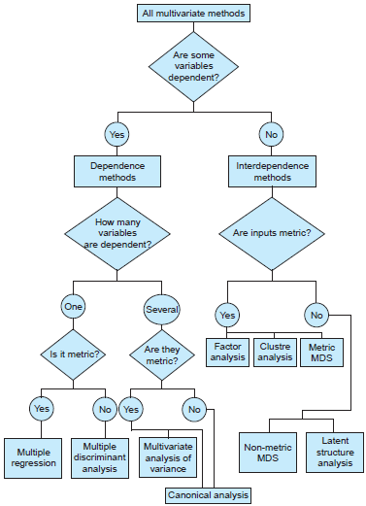
General Types of MVA
Analysis of dependence
One or more variables are dependent and explained or predicted by others
Analysis of interdependence
No variables thought of as “dependent”
Looks at relationships among variables, objects or cases

Slide 239
Interdependence Methods

Slide 240
Latent Variable
A hypothetical variable
Cannot be measured directly
No objective measurement unit
Inferred from observable manifestations
Multiple manifestations (indicators)
Normally distributed interval dimension
Cold
Cough
Sore Throat
Sneeze
Runny nose

Slide 241
Factor Analysis
Factor analysis is a class of procedures used for data reduction and summarization.
It is an interdependence technique: no distinction between dependent and independent variables.
Factor analysis is used:
To identify underlying dimensions, or factors, that explain the correlations among a set of variables.
To identify a new, smaller, set of uncorrelated variables to replace the original set of correlated variables.
Use factor loading of each variable on factors generated to determine usability of certain variable.

Slide 242
Some Applications of Factor Analysis
1. Identification of Underlying Factors:
Clusters variables into homogeneous sets
Creates new variables (i.e. factors)
Provides insight to categories
2. Screening of Variables:
Identifies one variable to represent many
Useful in regression (recall collinearity)
3. Summary:
Describes many variables using a few factors
4. Clustering of objects:
Puts objects into categories based on factor scores

Slide 243
Factor Loadings
Represent correlations between item and factor
High loadings define a factor
Low loadings indicate item does not “load” on factor
Other things to note:
Factors usually independent
Typically ‘name’ factors
Important to check validity
Range between -1 to 1
------------------------------------
Variable | Factor1 Factor2 |
-------------+--------------------+
notenjoy | -0.3118 0.5870 |
notmiss | -0.3498 0.6155 |
desireexceed | -0.1919 0.8381 |
personalpe~m | -0.2269 0.7345 |
importants~l | 0.5682 -0.1748 |
groupunited | 0.8184 -0.1212 |
responsibi~y | 0.9233 -0.1968 |
interact | 0.6238 -0.2227 |
problemshelp | 0.8817 -0.2060 |
notdiscuss | -0.0308 0.4165 |
workharder | -0.1872 0.5647 |
-----------------------------------
High loadings are bolded.

Slide 244
Methods for Estimating Model
Principal components analysis
Factors estimated using total variance.
Used to determine minimum number of factors that will account for maximum variance in data.
Each principal component is linear combination of the original variables.
Common factor analysis
Factors estimated based only on common variance.
Communalities inserted in diagonal of correlation matrix.
Used to identify underlying dimensions and when common variance is of interest.

Slide 245
Conducting a Factor Analysis
Problem formulation
Construction of the Correlation Matrix
Method of Factor Analysis
Determination of Number of Factors
Rotation of Factors
Interpretation of Factors
Calculation of Factor Scores
Determination of Model Fit

Slide 246
Criticisms of Factor Analysis
Factor labels can be arbitrary or lack scientific basis
Derived factors often very obvious
defense: but we get a quantification
“Garbage in, garbage out”
really a criticism of input variables
factor analysis reorganizes input matrix
Too many steps that could affect results
Too complicated
Correlation matrix often poor measure of association of input variables.

Slide 247
Cluster Analysis
Inter-cluster distances are maximized
Intra-cluster distances are minimized
Goal is to find groups of objects such that objects in a group will be similar (or related) to one another and different from (or unrelated to) objects in other groups

Slide 248
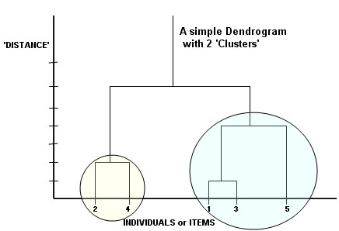
Main Types of Cluster Analysis Methods
Hierarchical cluster analysis
Each cluster (starting with the whole dataset) is divided into two, then divided again, and so on
Iterative methods
k-means clustering
Analogous non-parametric density estimation method
Other methods
Overlapping clusters
Fuzzy clusters

Slide 249
Notion of a Cluster can be Ambiguous
How many clusters?
Six Clusters
Two Clusters
Four Clusters

Slide 250
Types of Clusterings
A clustering is a set of clusters
Important distinction between hierarchical and partitional sets of clusters
Partitional Clustering
Division data objects into non-overlapping subsets (clusters) such that each data object is in exactly one subset
Hierarchical clustering
Set of nested clusters organized as hierarchical tree

Slide 251
Partitional Clustering
Original Points
A Partitional Clustering

Slide 252
Hierarchical Clustering
Traditional Hierarchical Clustering
Traditional Dendrogram
Non-traditional Hierarchical Clustering
Non-traditional Dendrogram

Slide 253
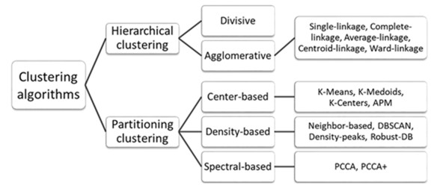
Clustering Algorithms
K-means and its variants
Hierarchical clustering
Latent class analysis

Slide 254
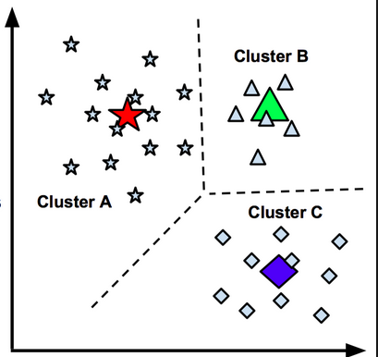
K-means Clustering
Partitional clustering approach
Each cluster associated with centroid
Initial centroids chosen randomly.
Typically mean of points in cluster
Points assigned to cluster with closest centroid.
Closeness’ is measured by Euclidean distance, cosine similarity, correlation, etc.
Most common measure is Sum of Squared Error (SSE)
Given two clusters, choose one with smallest error
Number of clusters, K, must be specified
Can reduce SSE by increasing K

Slide 255
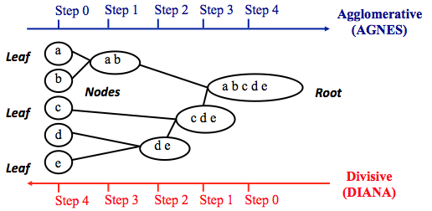
Hierarchical Clustering
Produces a set of nested clusters organized as a hierarchical tree
Do not have to assume any particular number of clusters
Two main types
Agglomerative: Start with points as individual clusters and merge closest pair at each step until K clusters left
Divisive: Start with one, all-inclusive cluster and split cluster at each step until there are K clusters

Slide 256
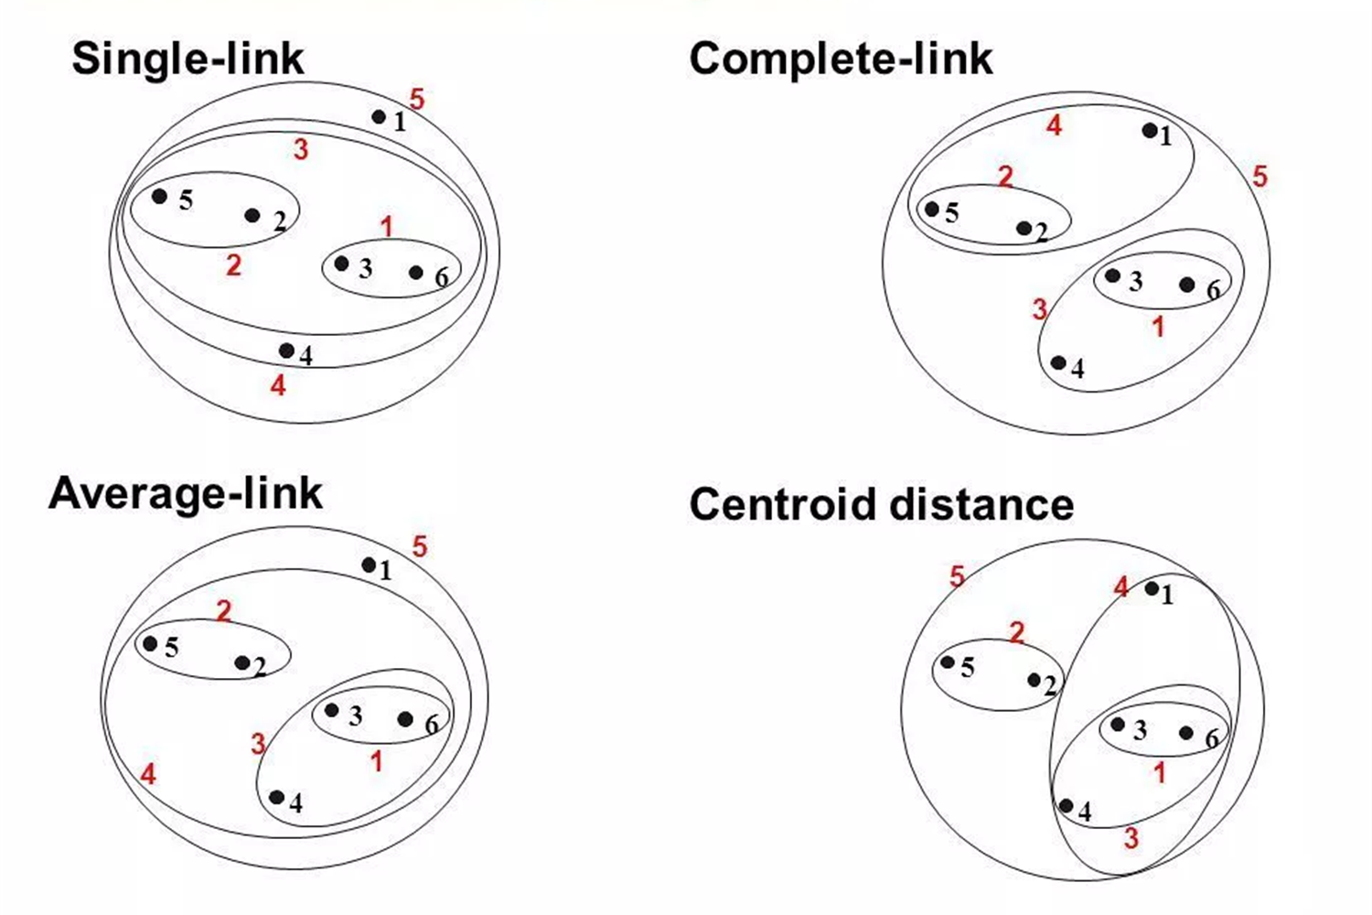
Hierarchical Clustering Methods
Single-link | Complete-link | Average-link | Centroid distance Image Credit:: http://slideplayer.com/slide/9336538/

Slide 257
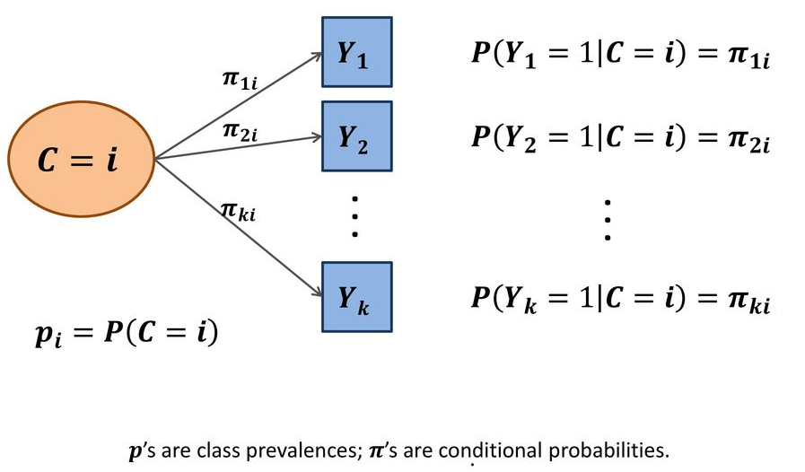
Latent Class Analysis
Categorical factors, indicator variables
Can deal with variables with different scale types
Allows for fractional cluster membership
Classify units to latent classes using posterior probabilities (rather than distance)
Can include covariates
Types
Exploratory LCA
Confirmatory LCA
Latent Transition Analysis

Slide 258
Factor Analysis vs Cluster Analysis
Both are data reduction techniques.
Goal of Factor Analysis is to reduce original set of variables to smaller set of factors.
Goal of Cluster Analysis is to form groups from the people or objects, thus reducing original number of elements to fewer groups.
Factor Analysis can be seen as a clustering technique that is focused on the columns of data matrix, rather than the rows.

Slide 259
Dependence Methods

Slide 260
Discriminant Analysis
Used to classify individual in one of two or more groups based on set of measurements
Criterion or dependent variable is categorical.
Similar to regression and MANOVA
Objectives:
Develop discriminant functions, or linear combinations of the predictor or independent variables, that best discriminate between groups
Examine whether significant differences exist among groups in terms of predictor variables.
Determine which predictor variables contribute to most of intergroup differences.
Create groups based on values of predictor variables.
Evaluate accuracy of classification.

Slide 261
Conducting Discriminant Analysis
Identify objectives, criterion variable, independent variables.
Criterion variable must consist of two or more mutually exclusive and collectively exhaustive categories.
Predictor variables should be selected based on theoretical model, previous research, or experience.
Divide sample in two:
Estimation sample for estimating discriminant function.
Holdout or validation sample reserved for validating discriminant function.
Often distribution of cases in analysis and validation samples follows distribution in total sample.

Slide 262
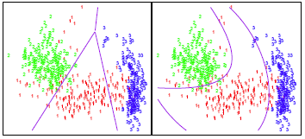
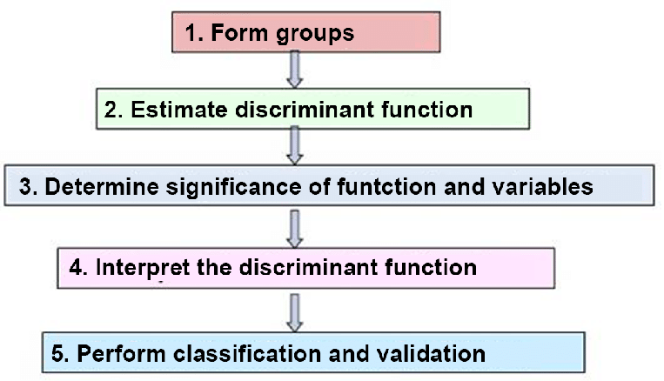
Conducting Discriminant Analysis

Slide 263
Discriminant Analysis vs Cluster Analysis
In Discriminant Analysis, groups known a priori
All observations are supposed to be correctly classified at outset.
Objective is to predict classification from predictor variables.
Cluster Analysis is used when natural clusterings are not known.
Begins with groups that are undifferentiated, and tries to form groups and subgroups.
Objective is to discover is there are any natural groups.

Slide 264
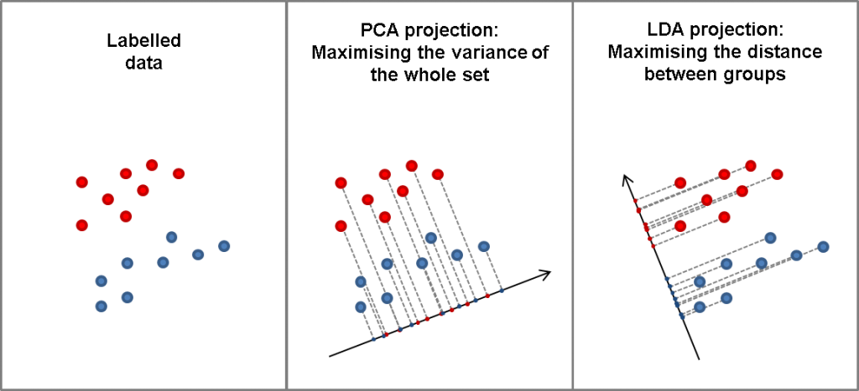
Discriminant Analysis vs PCA

Slide 265
Multiple Analysis of Variance (MANOVA)
Analysis of multiple dependent interval variables
Goal is to determine if individual categorical independent variables have an effect on a group, or related set of interval dependent variables.
Independent variables are categorical
Multiple dependent variables that are continuous and interval
Takes relationships between dependent variables into account
Number of observations for each combination of factor are same (balanced experiment)
Better than conducting multiple ANOVAs

Slide 266
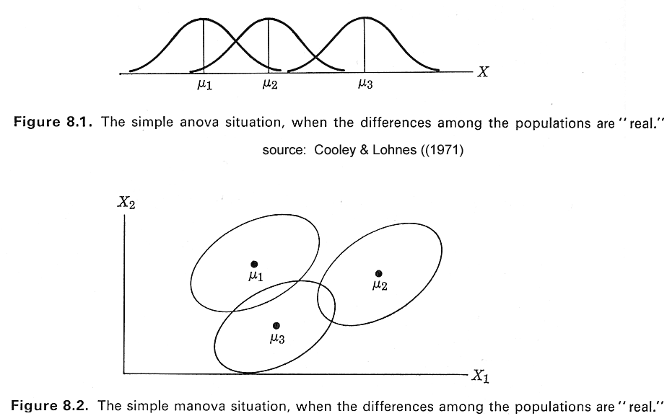
ANOVA vs MANOVA

Slide 267
MANOVA Assumptions
Multivariate normality
All DVs normally distributed
Linear combinations of DVs normally distributed
All subsets of variables have multivariate normal distribution
Homogeneity of the covariance matrices
Variance shared between any two variables equal across all levels of the independent variable
Independence of observations
Dependent measures not influenced by or related to scores of other subjects in condition or level
Tested with an intraclass correlation coefficient

Slide 268
Structural Equation Modeling (SEM)
Combination of factor analysis and regression
Tests relationships variables
Specify models that explain data with few parameters
Flexible - Works with continuous and discrete variables
Significance testing and model fit
Fits specified causal structures (path models) that usually involve factors or latent variables
Confirmatory approach
Needs large sample size to get stable estimates
@ 200 subjects for small to medium sized model
A minimum of 10 subjects per estimated parameter
Also affected by effect size and power

Slide 269
SEM Example
FIGURE 2. FINAL MODEL
Cantaloupe
Fever
Days ill
Watery Diarrhea
Headache
Pineapple
Nausea
Bake potato
Healthy/Fruit
Vomit
Citrus Bowl
Chills
Veggie plate
Rice Krispie
Mild/Moderate
Illness
Banana
School
Cob Corn
Age
Any Fruit
Sex
French Toast
Diarmeds
Antibiotic
Meat
Stool Sample
Corndogs
Severe Illness
Any Beef
Chix Casserole
Chix Spaghetti Cass
Any Chicken
Ice/Cafeteria
Bloody Diarrhea
Bring Food
Number of Diarrhea per day
Cafeteria Ice
Medical visit
Any Cafeteria

Slide 270
A Structured Approach to Multivariate Model Building
Stage 1: Define research problem, objectives, and multivariate technique to be used
Stage 2: Develop analysis plan
Stage 3: Evaluate assumptions underlying multivariate technique
Stage 4: Estimate multivariate model and assess overall model fit
Stage 5: Interpret variate(s)
Stage 6: Validate multivariate model

Slide 271
Questions?

